Slide 1
Yard in April 13 Princeton Rd
by Michele

Slide 2
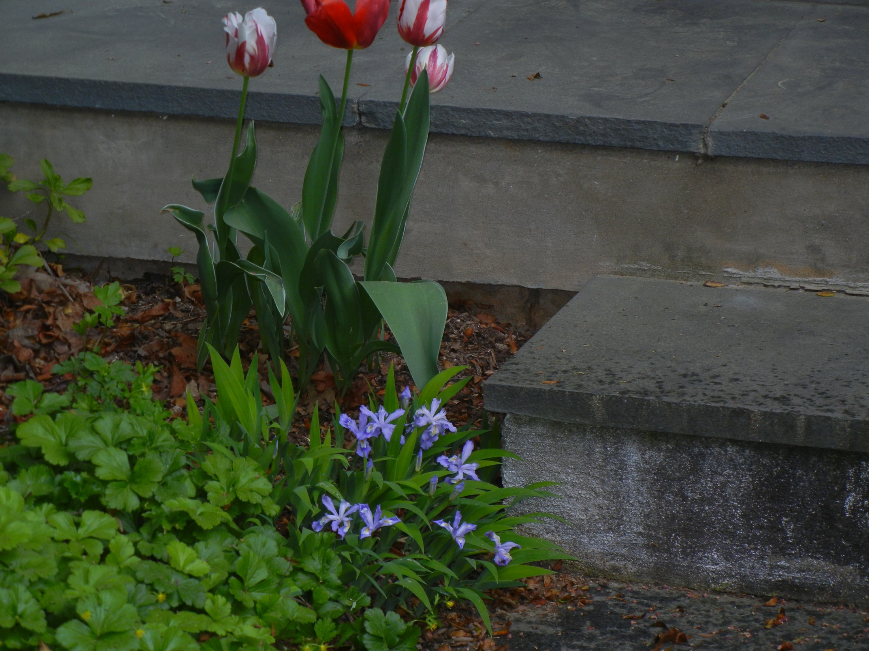
By the front door

Slide 3
Dwarf crested iris
Barren strawberry

Slide 4
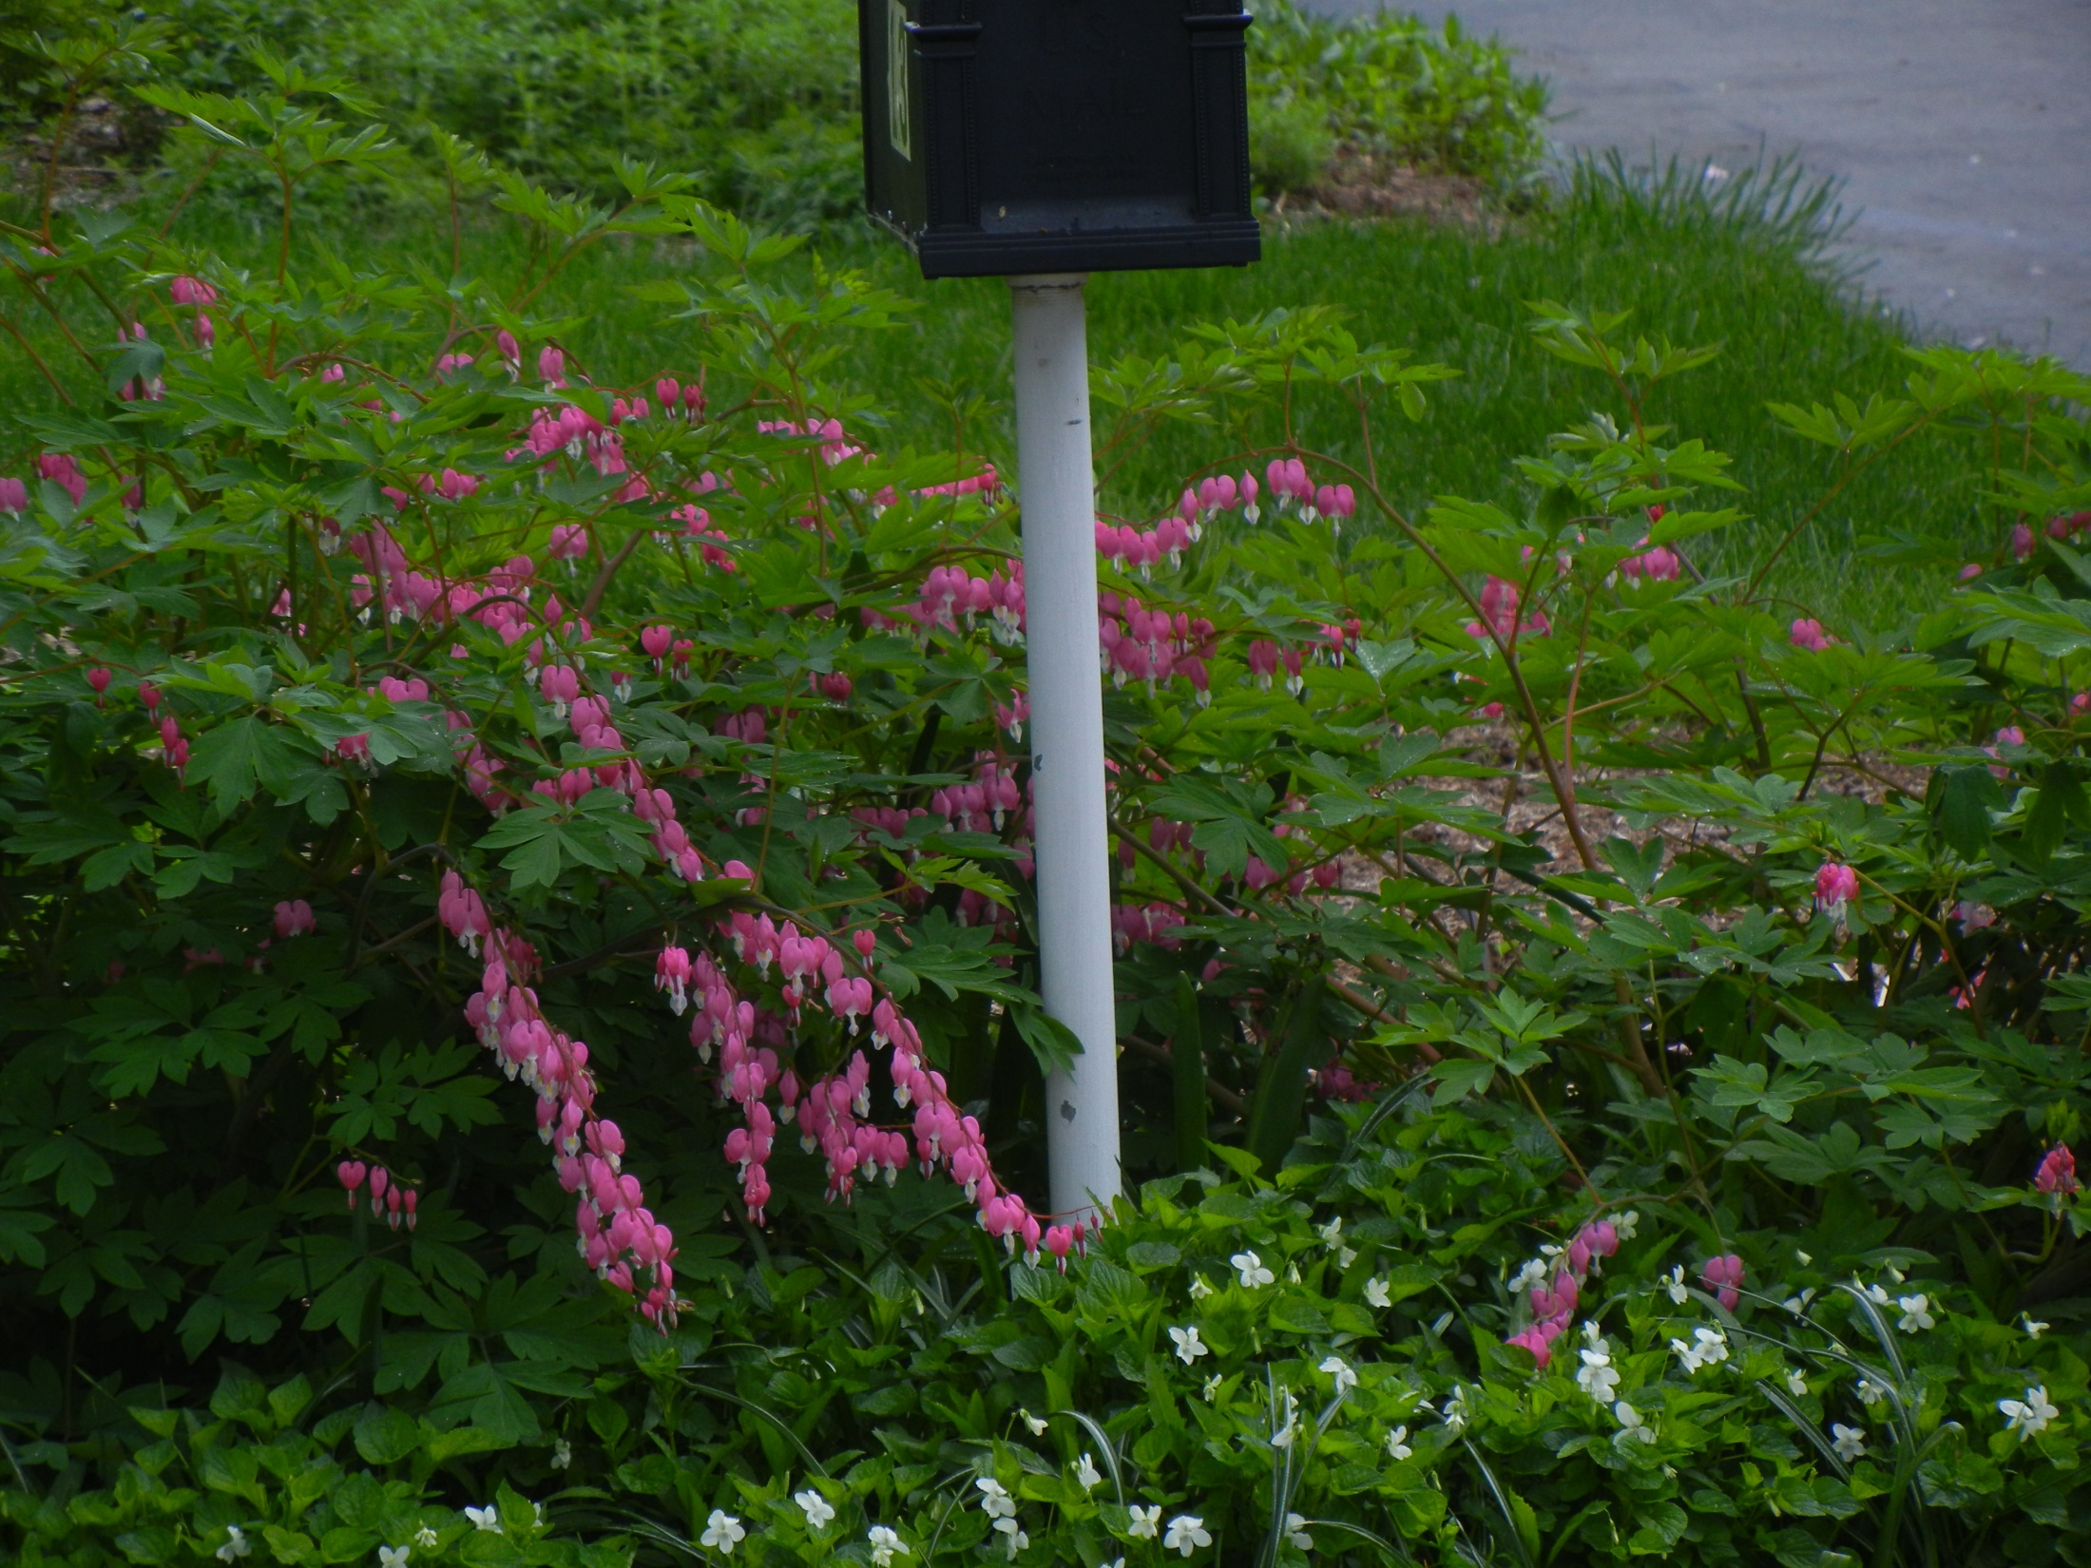
Bleeding heart
White violets

Slide 5
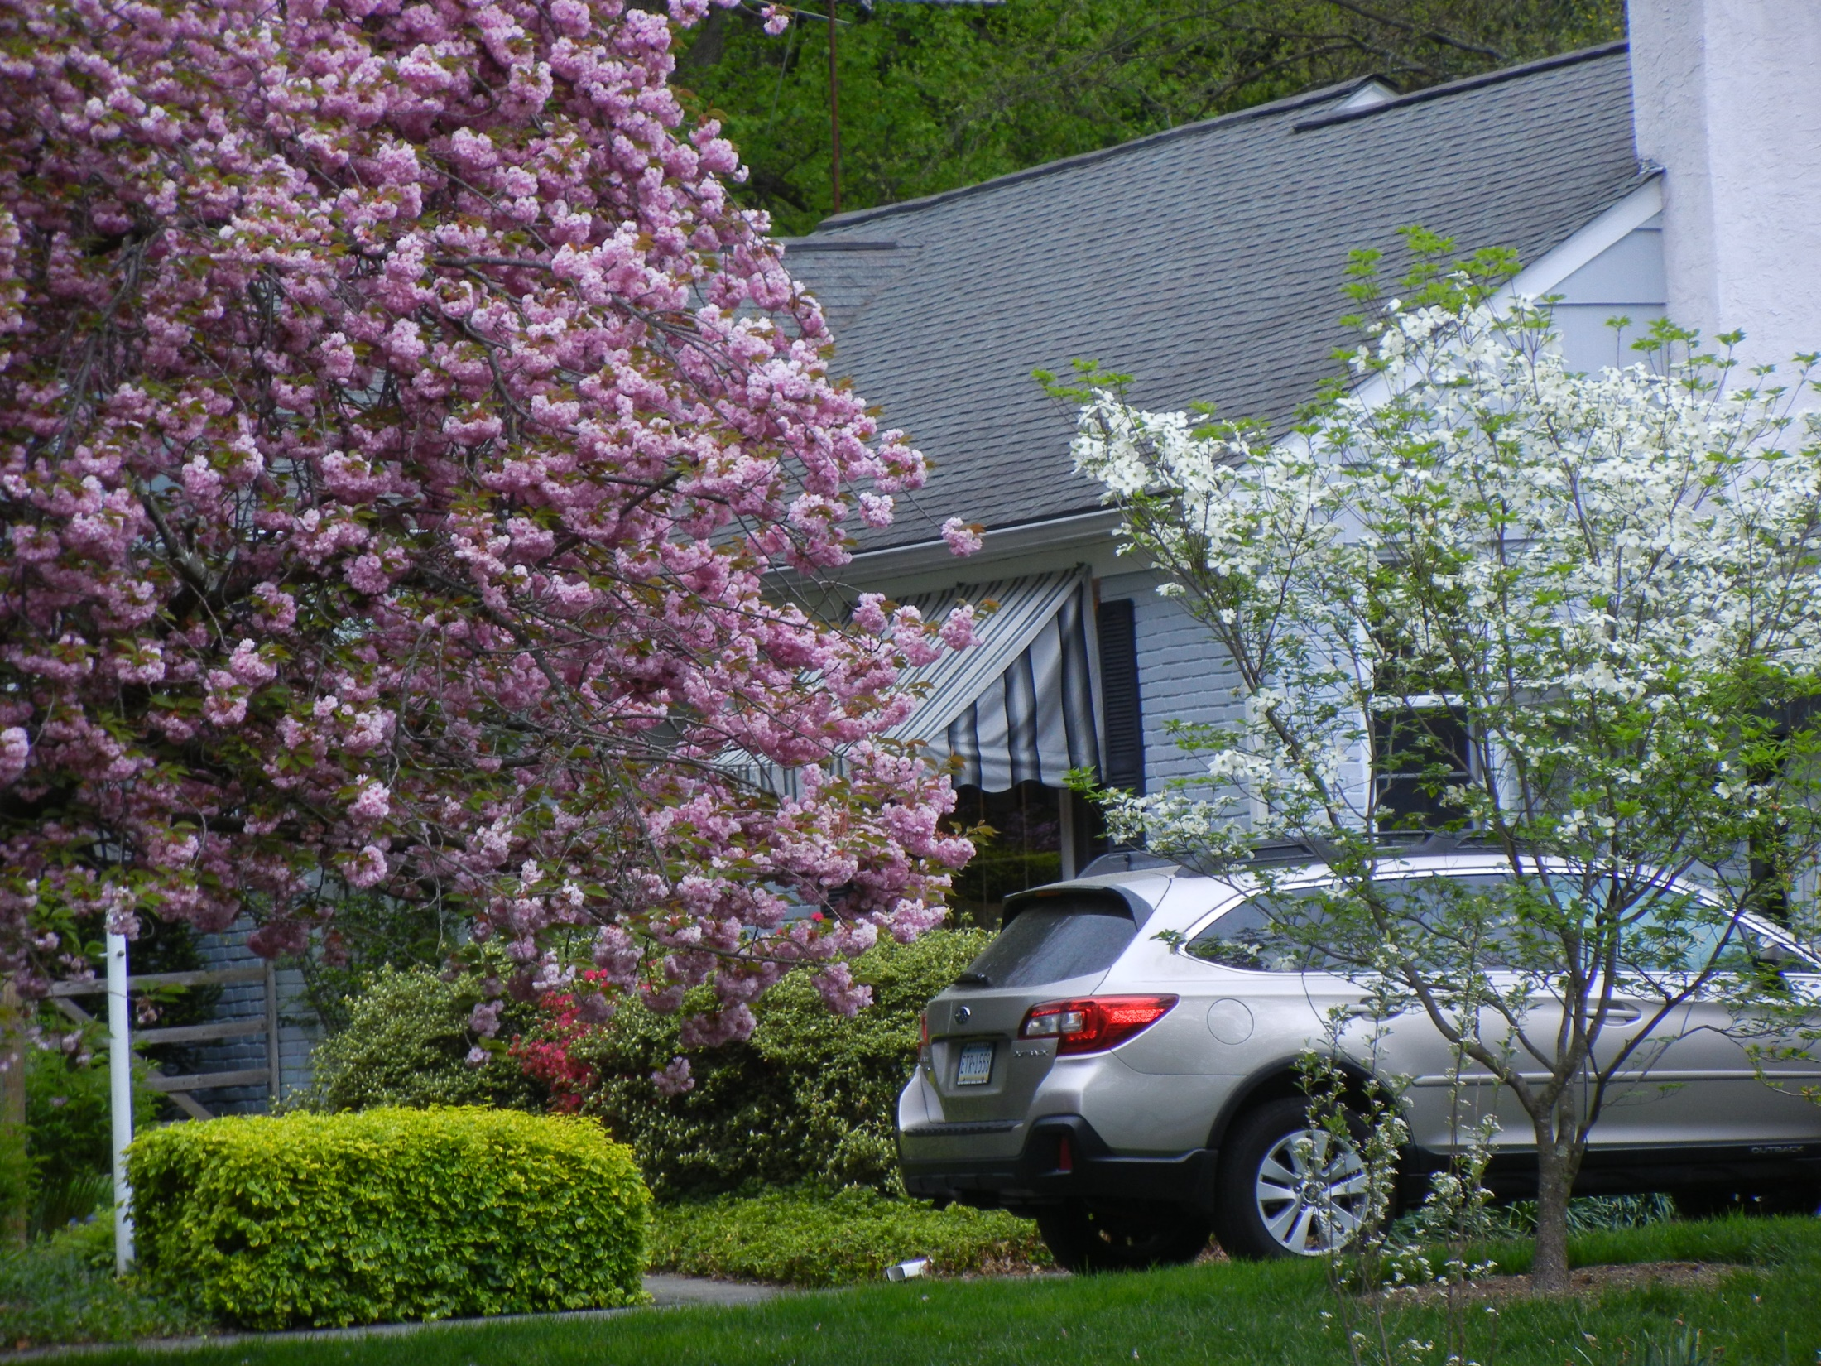
Kwansan Cherry tree
Evergreen azaleas
‘Cherokee Princess’
Flowering dogwood

Slide 6
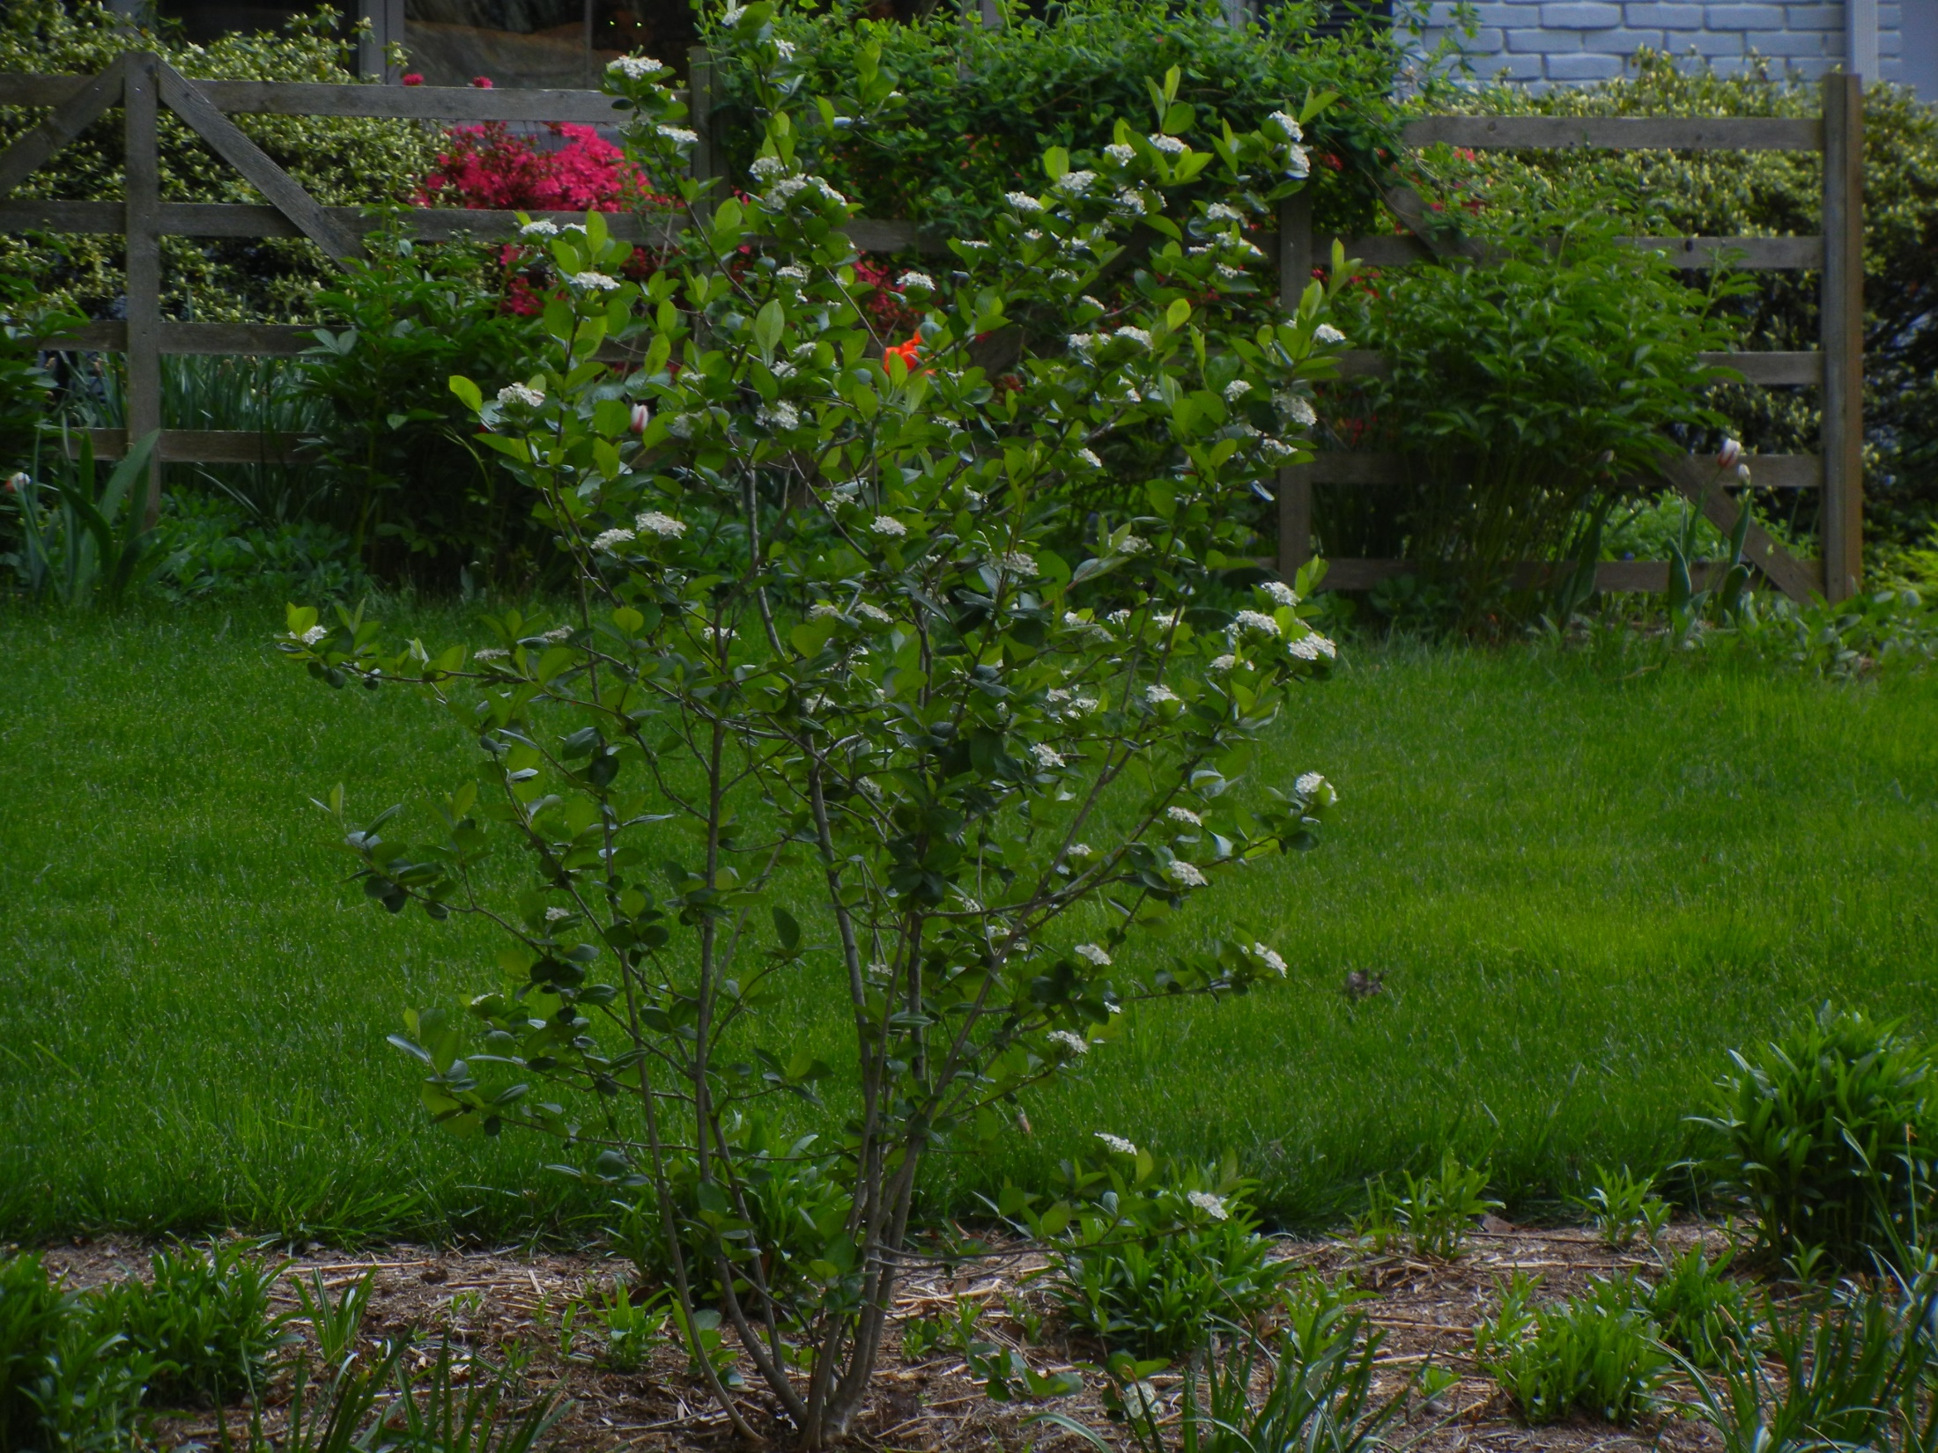
Front yard – black chokeberry ‘Viking’’

Slide 7
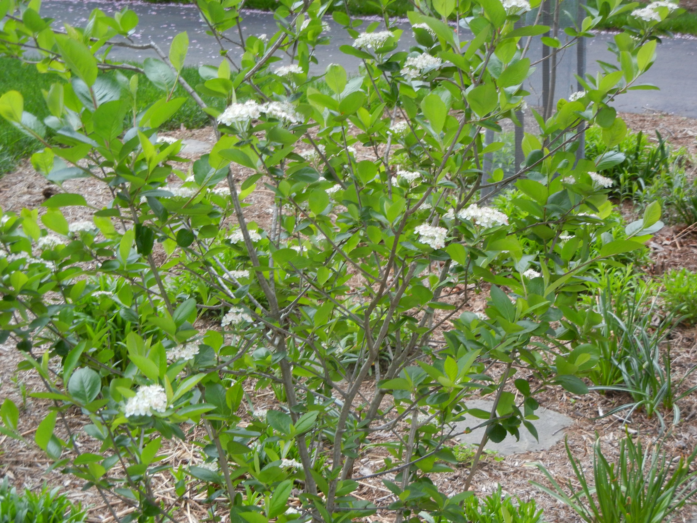
Front yard – black chokeberry ‘Viking’

Slide 8
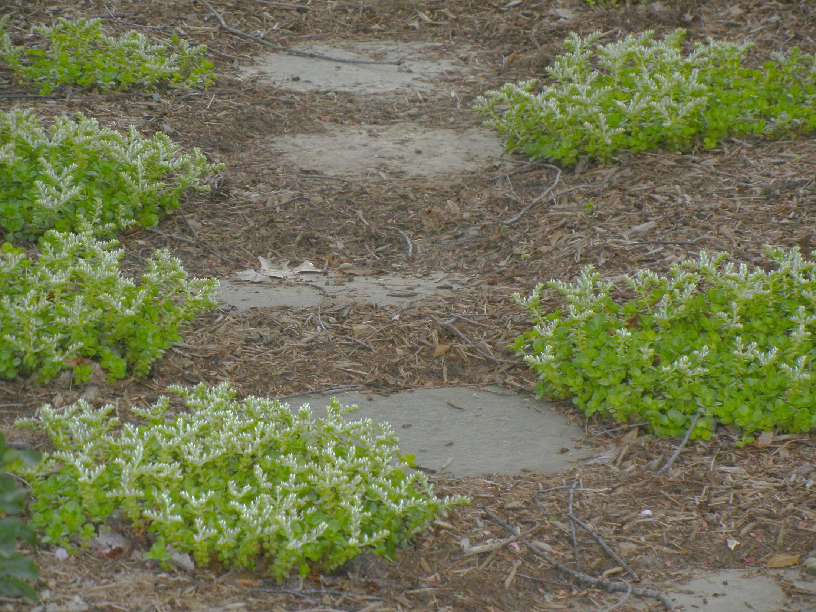
Front yard - woodland stonecrop

Slide 9
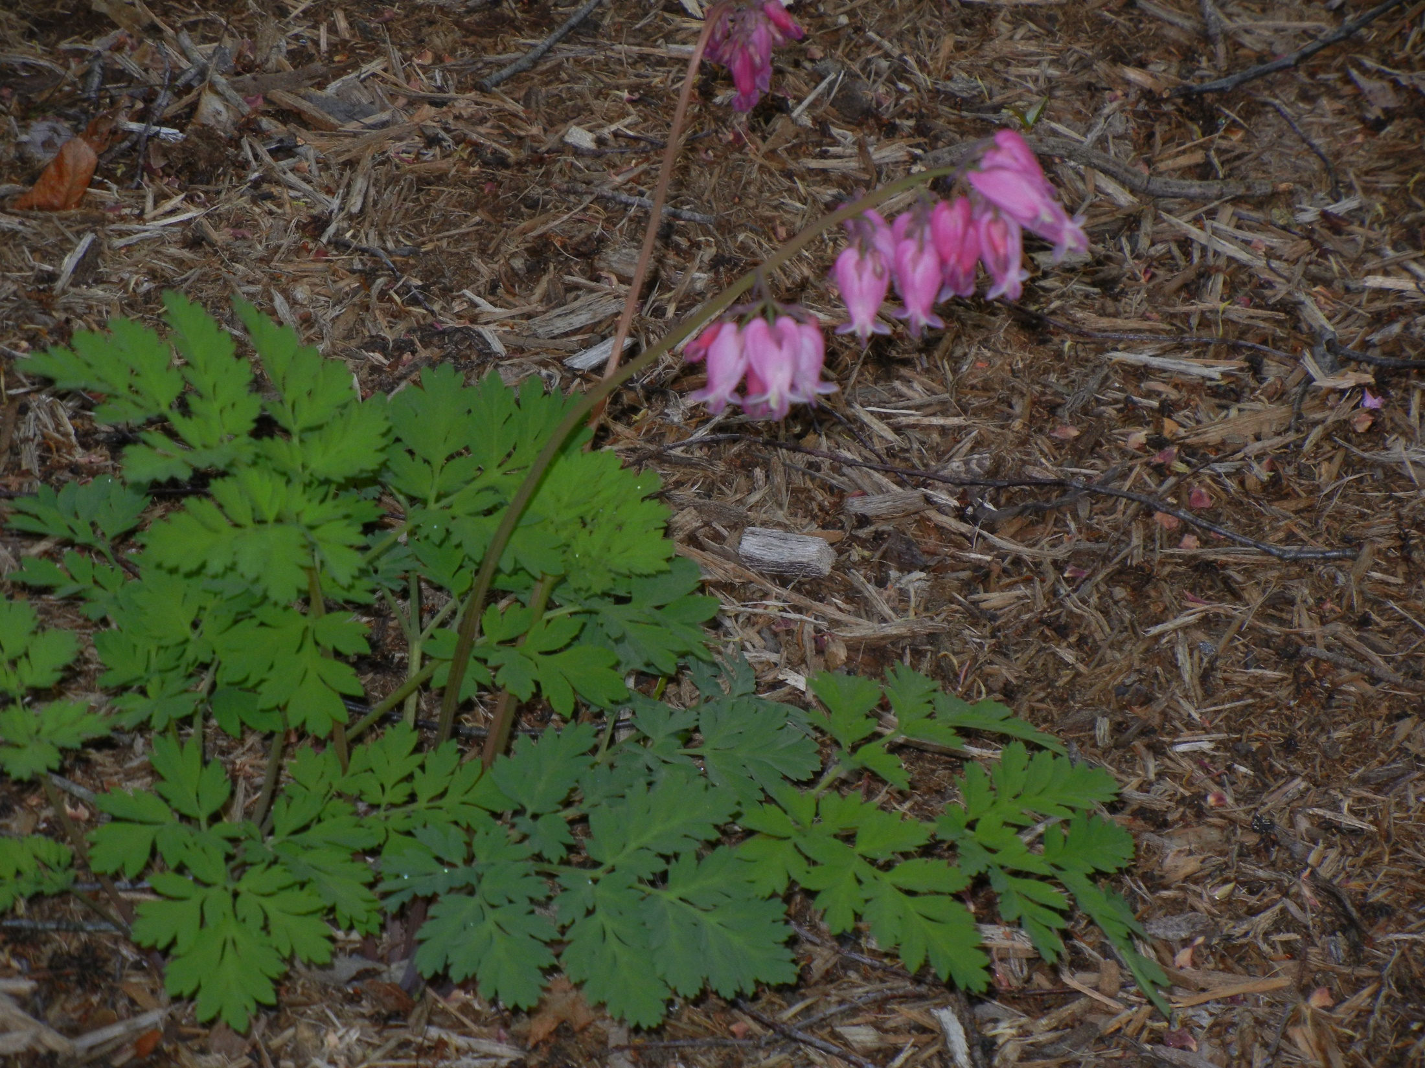
Front yard –native bleeding heart

Slide 10
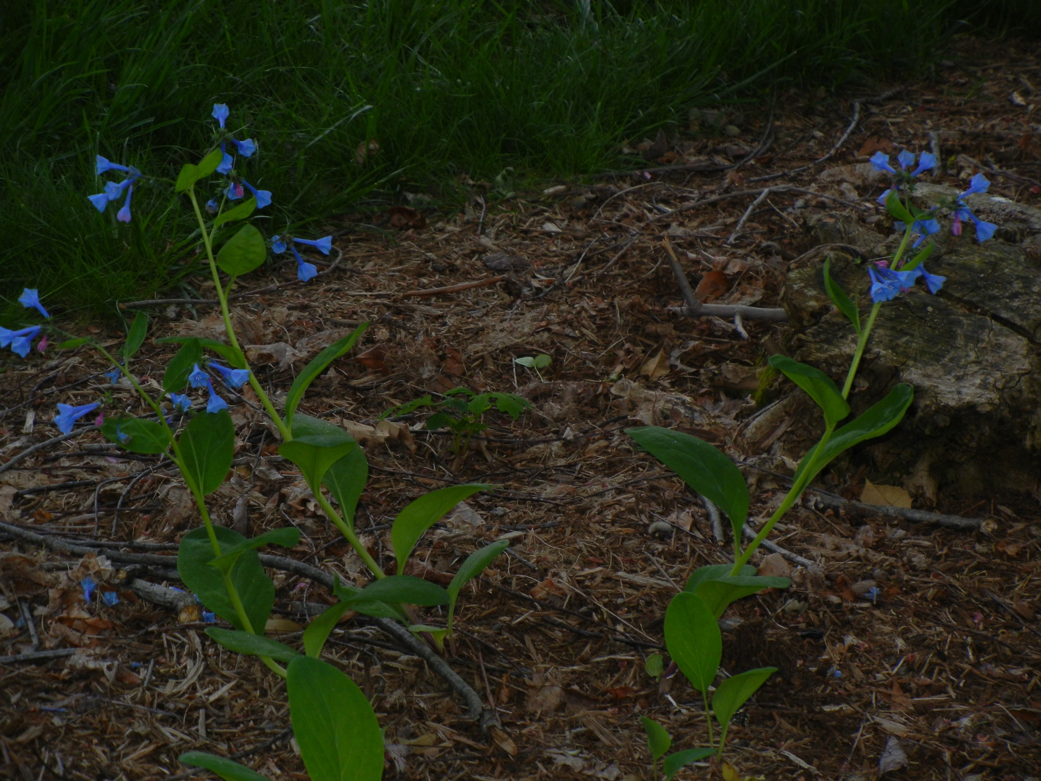
Front yard – Virginia Bluebells

Slide 11
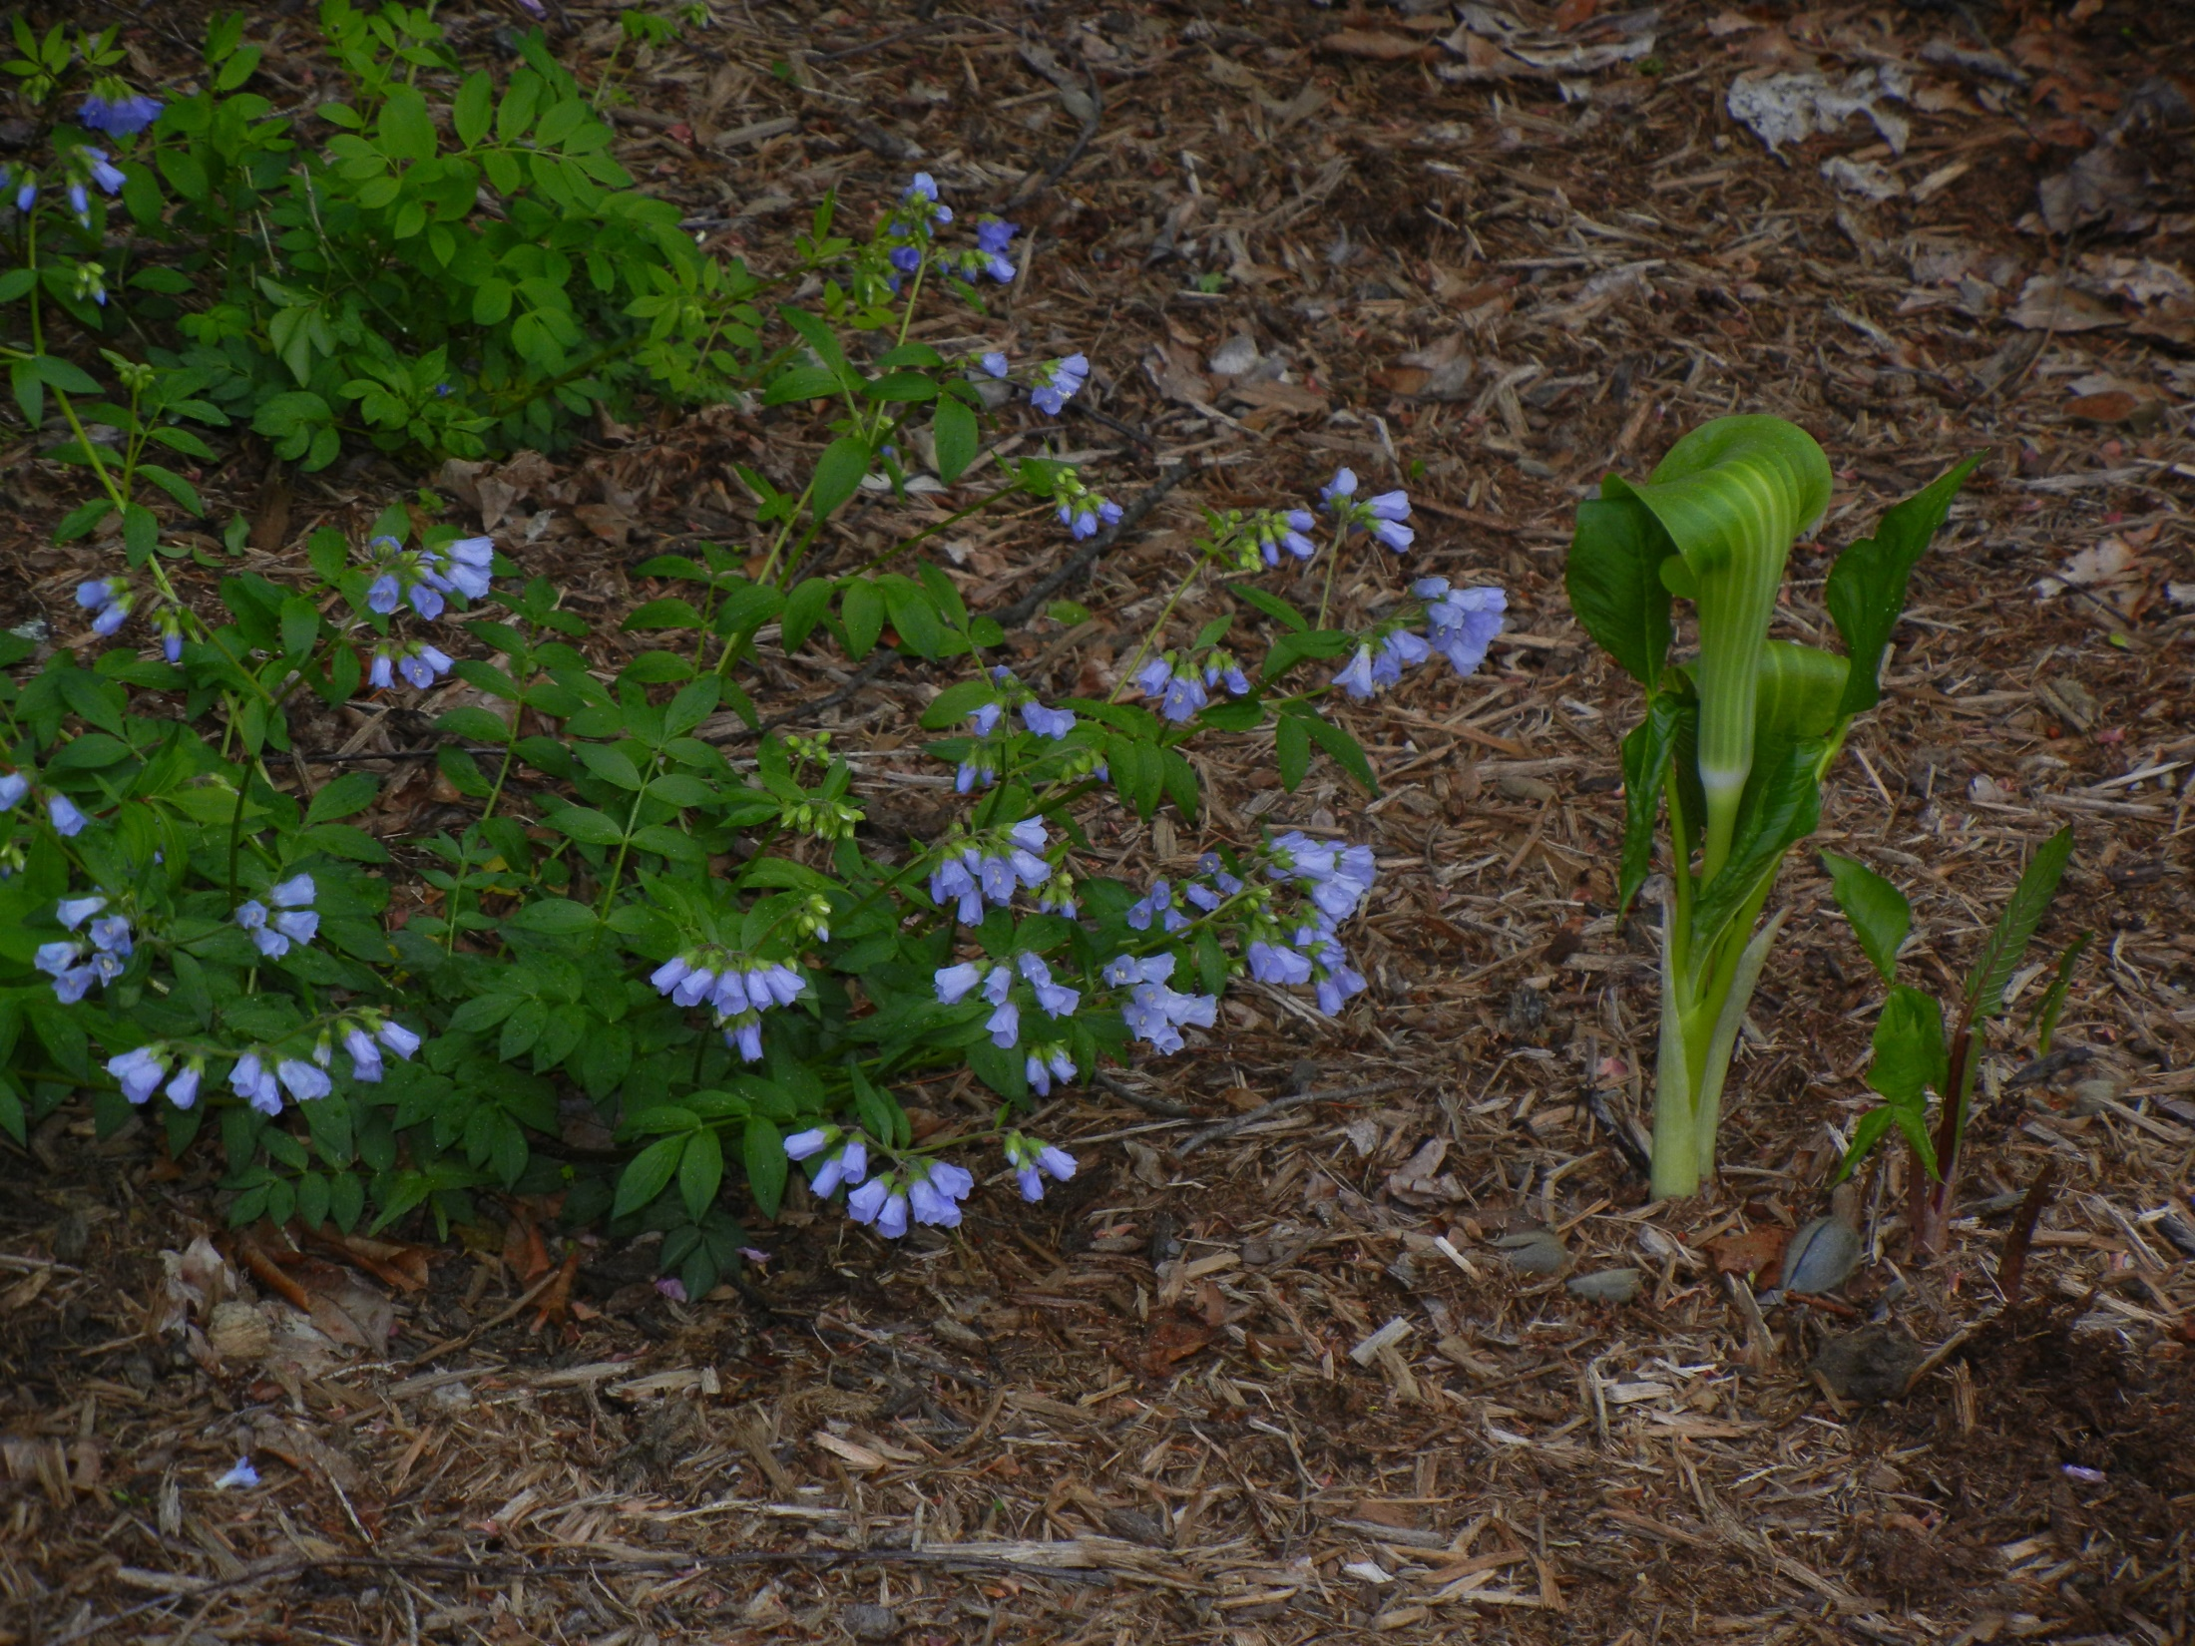
Front yard - Jacob’s ladder
Jack-in-the-pulpit

Slide 12
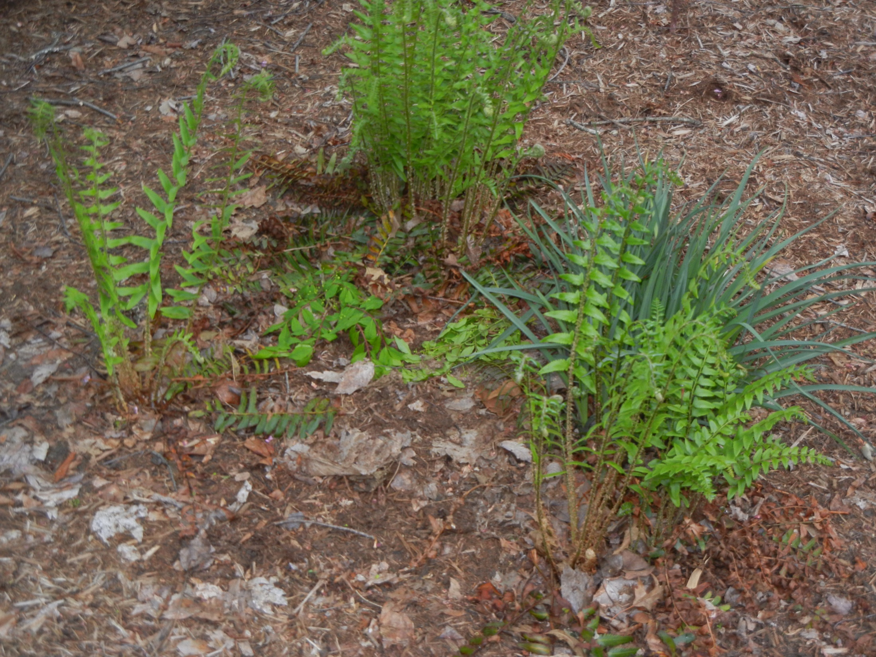
Spiderwort
Front yard Christmas Fern

Slide 13
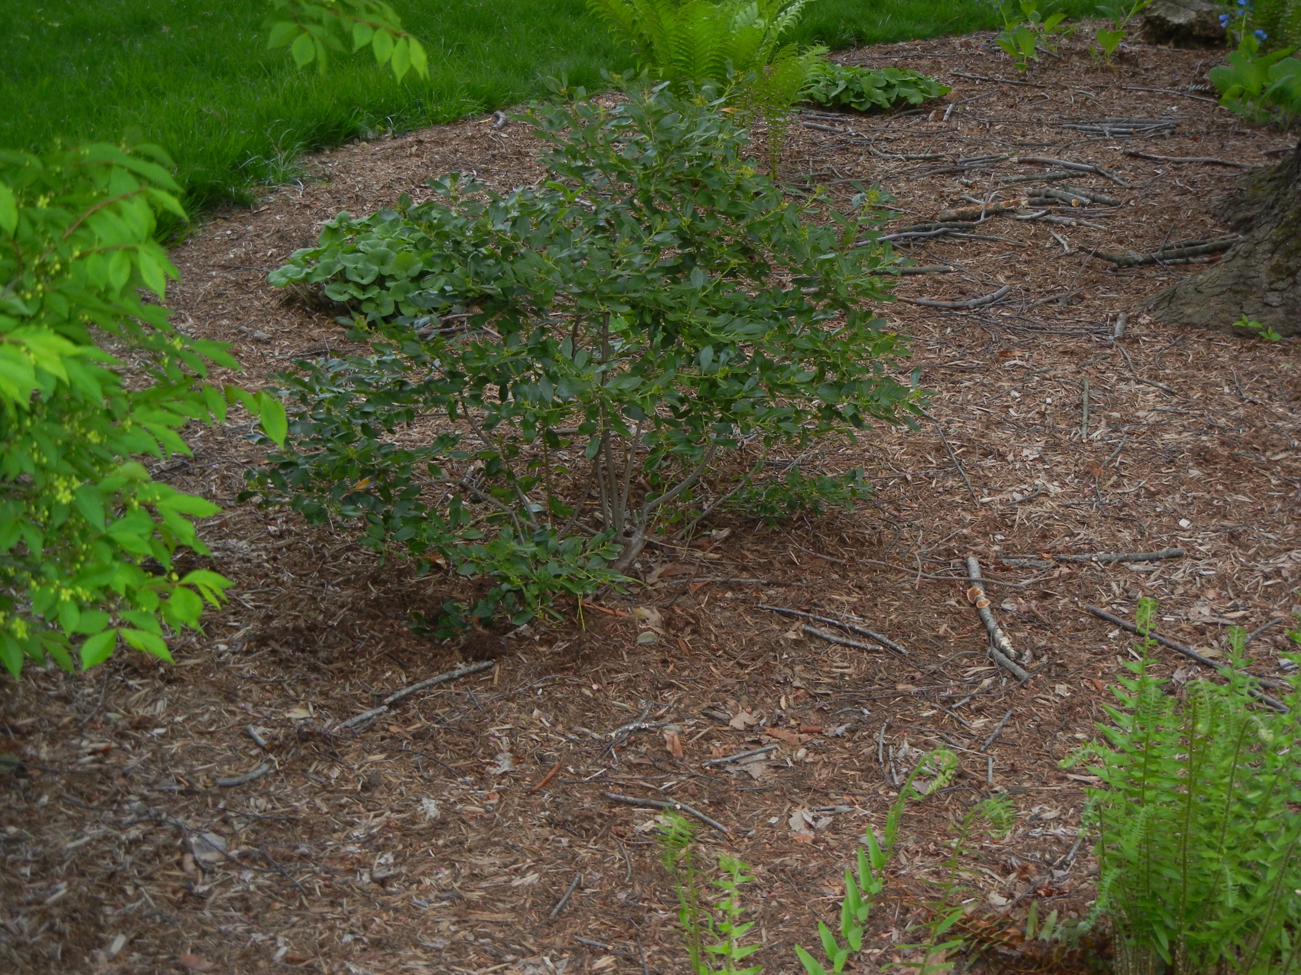
Ilex glabra ‘Compacta’

Slide 14
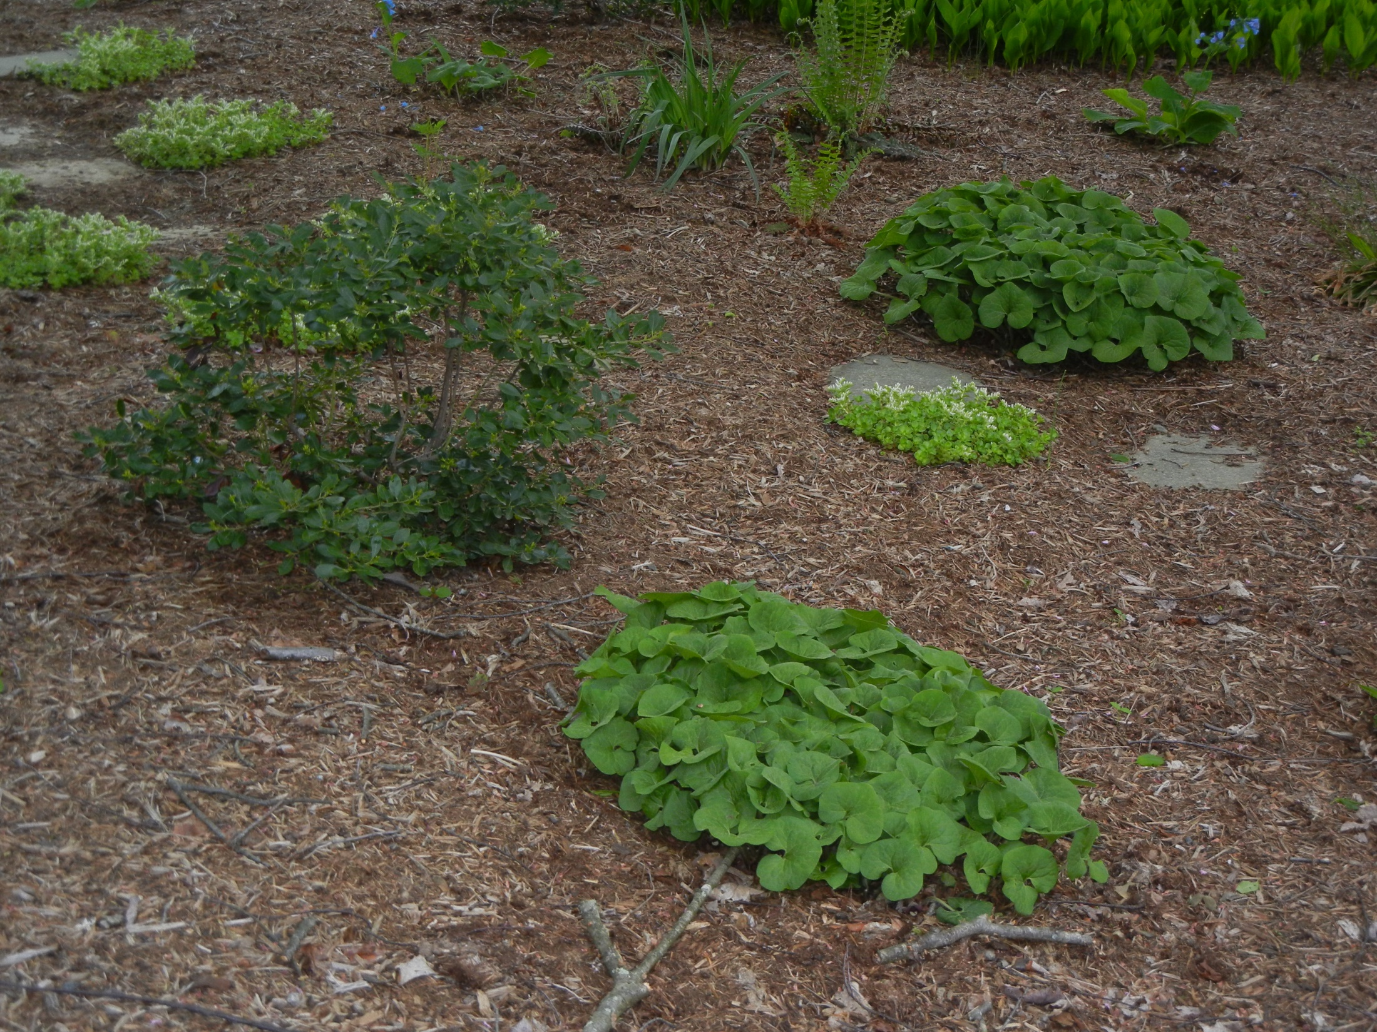
Lily of the Valley
Christmas fern
Spiderwort
Virginia bluebells
Wild Ginger
Woodland Stonecrop
Ilex glabra ‘Compacta
Wild Ginger
Front yard Street Planting

Slide 15
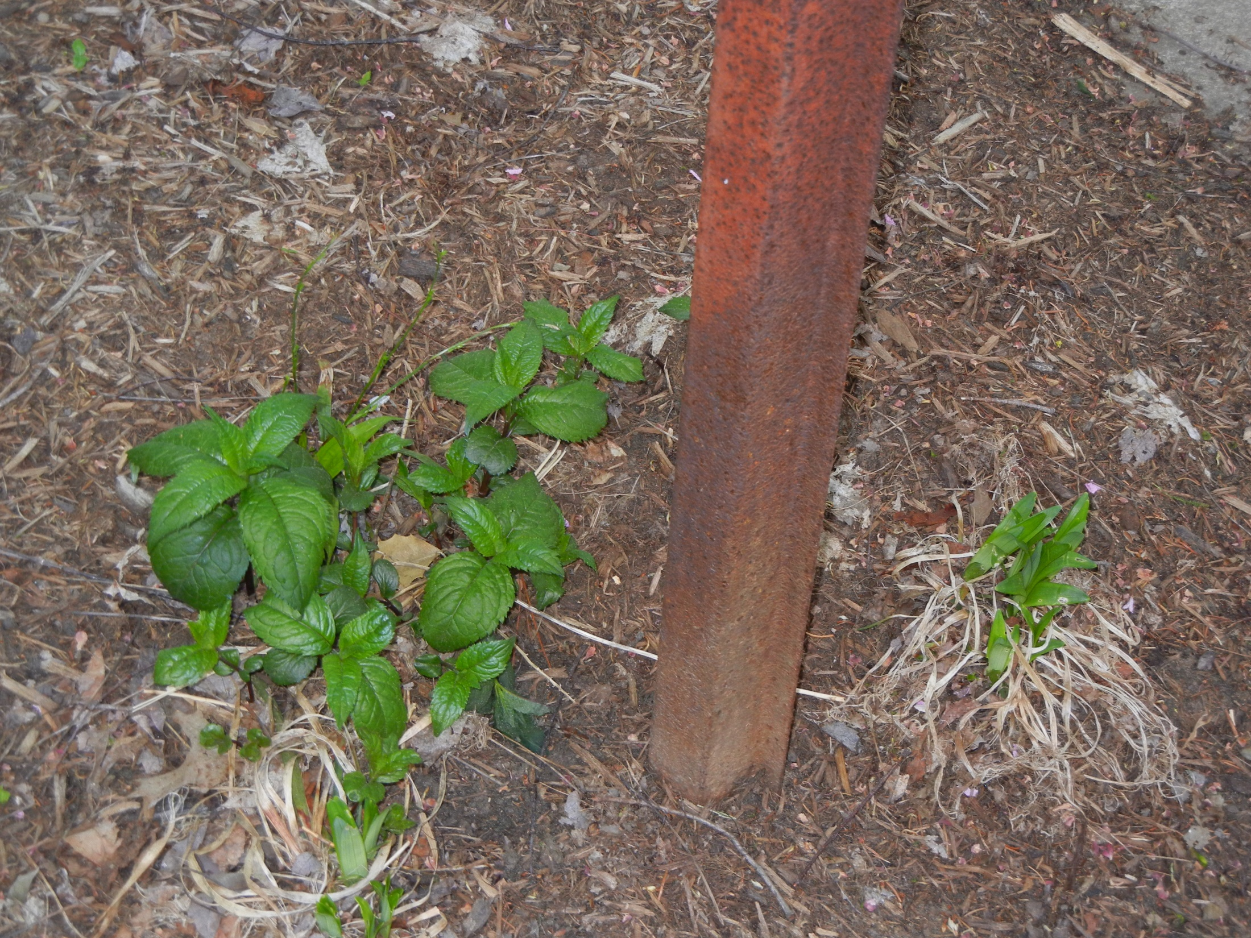
25 mile/hr
Street sign front yard
Turtlehead ‘Hotlips’

Slide 16
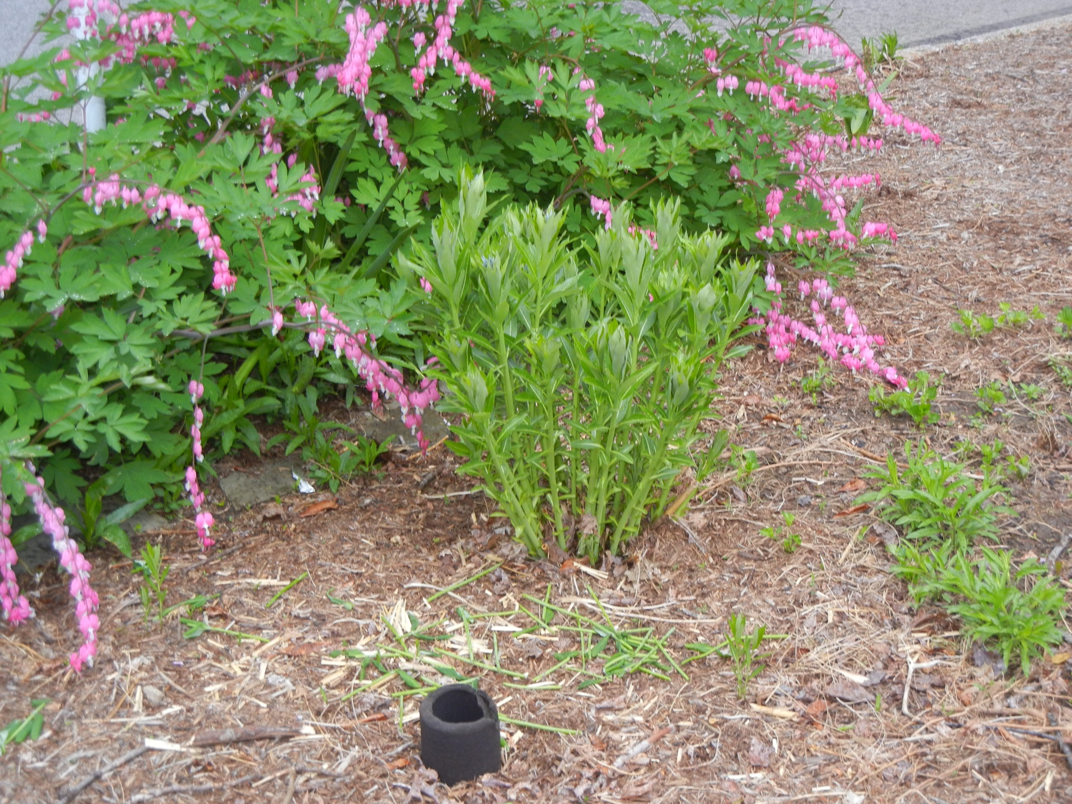
Bluestar (Amsonia tabernaemontana)

Slide 17
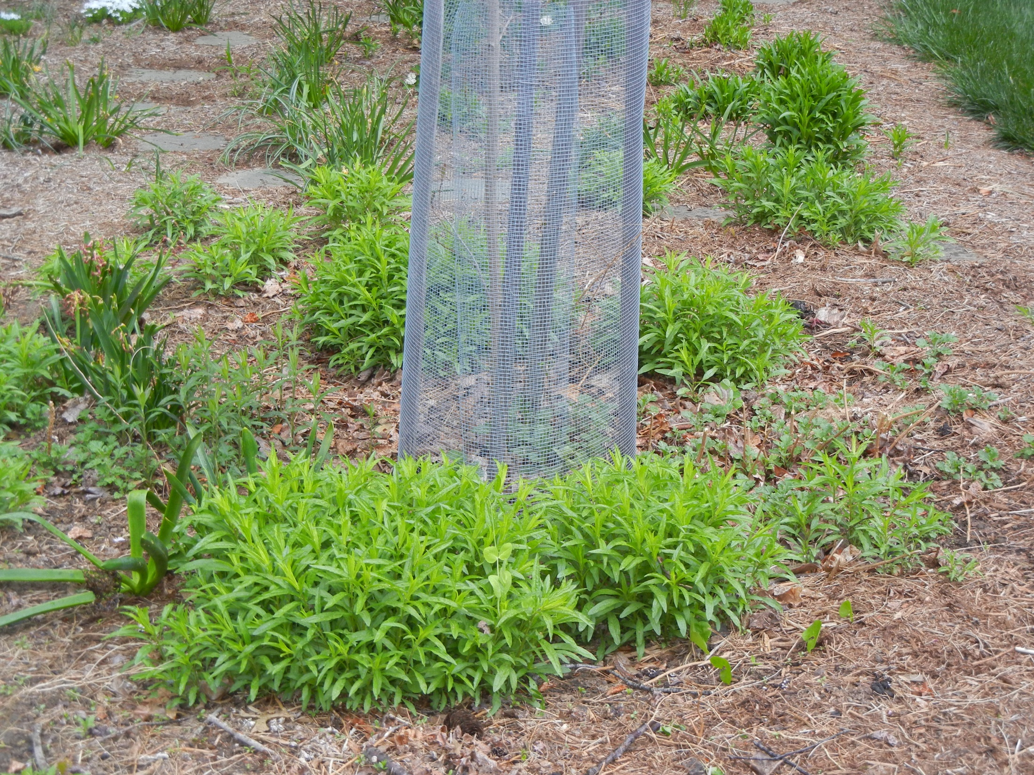
Obedient Plant
‘Miss Manners’
daffodils
Young Sugar Maple
Hyacinths
NewEngland Aster

Slide 18
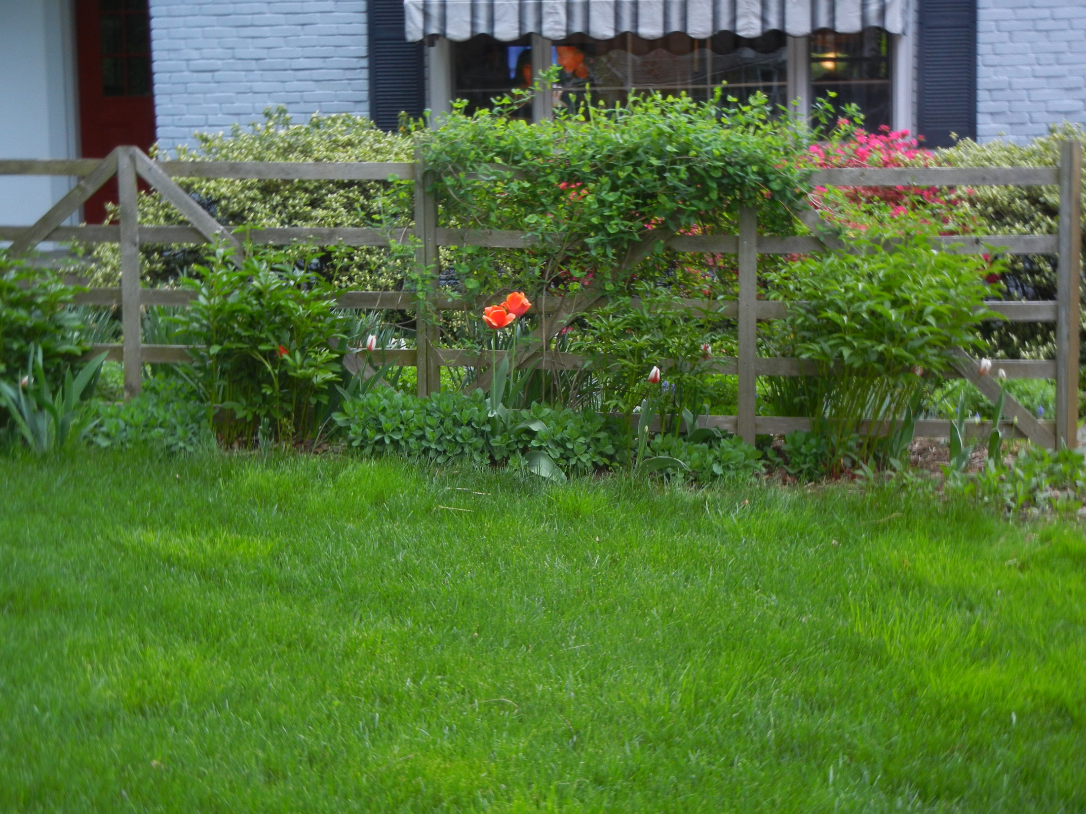
Native honeysuckle
Lonicera sempervirens
Evergreen Azaleas
peonies
Tulips
Iris
Sedum

Slide 19
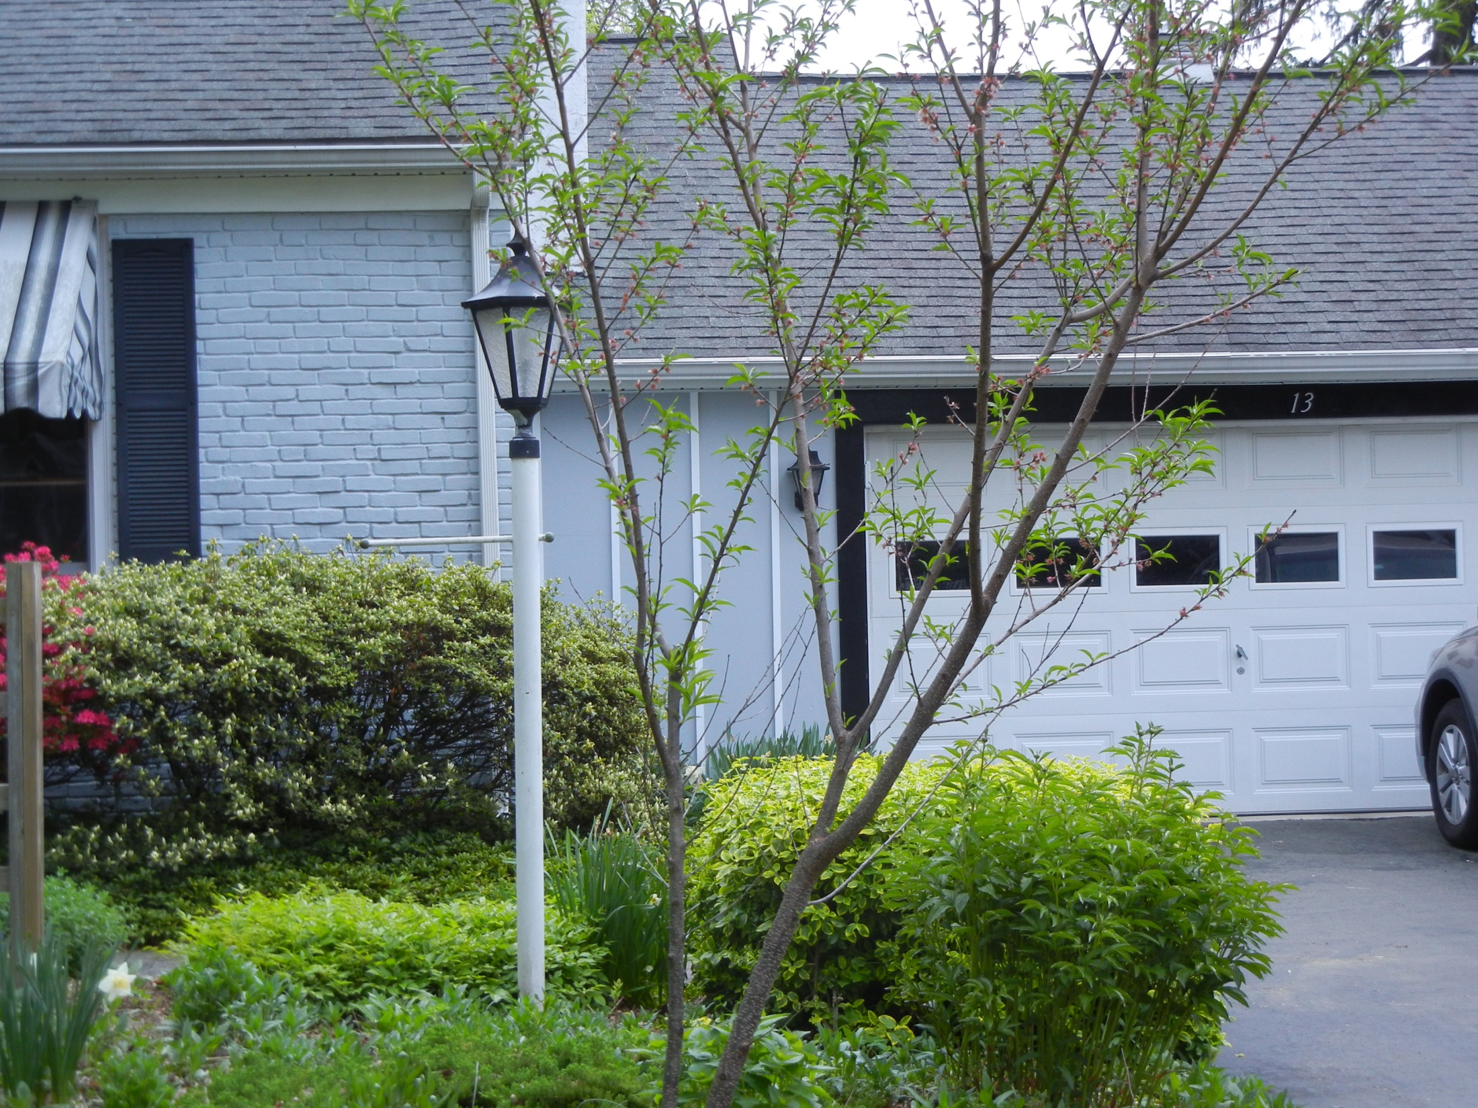
Methley Plum tree
Dwarf variety

Slide 20
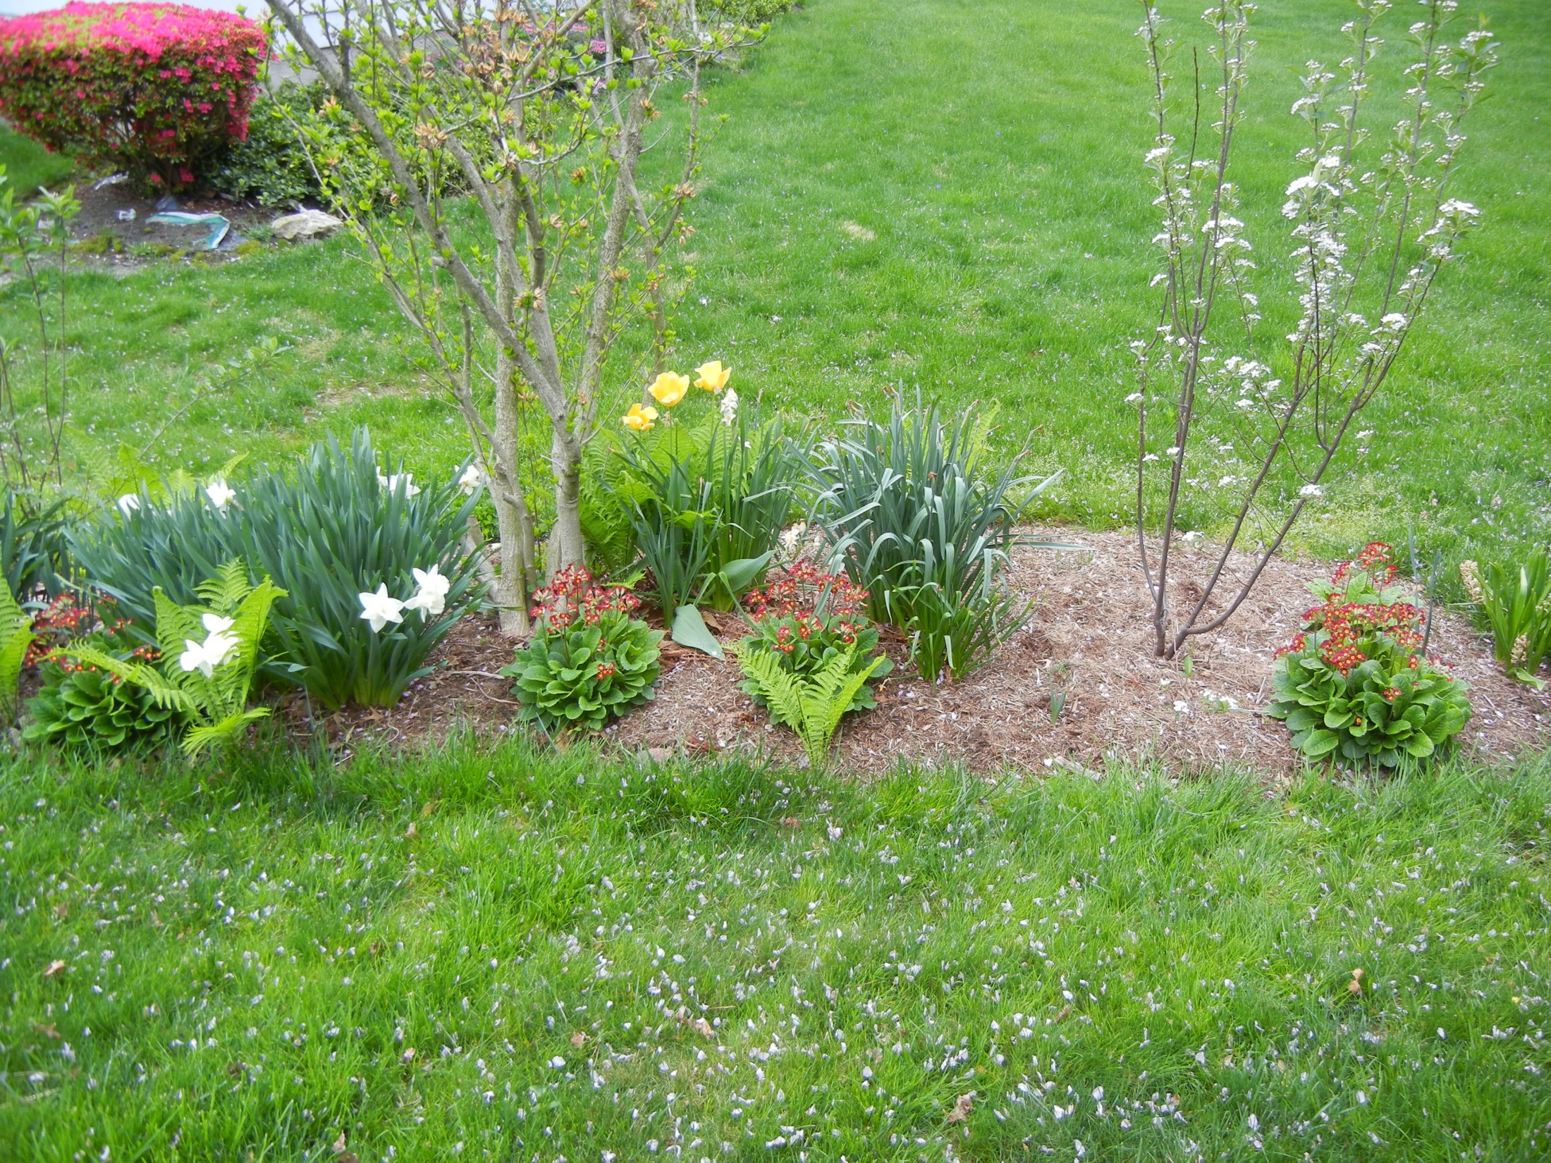
Rose of Sharon
Red Chokeberry
tulips
daffodils
Red Chokeberry
Ostrich fern
Primrose
Front – side yard

Slide 21
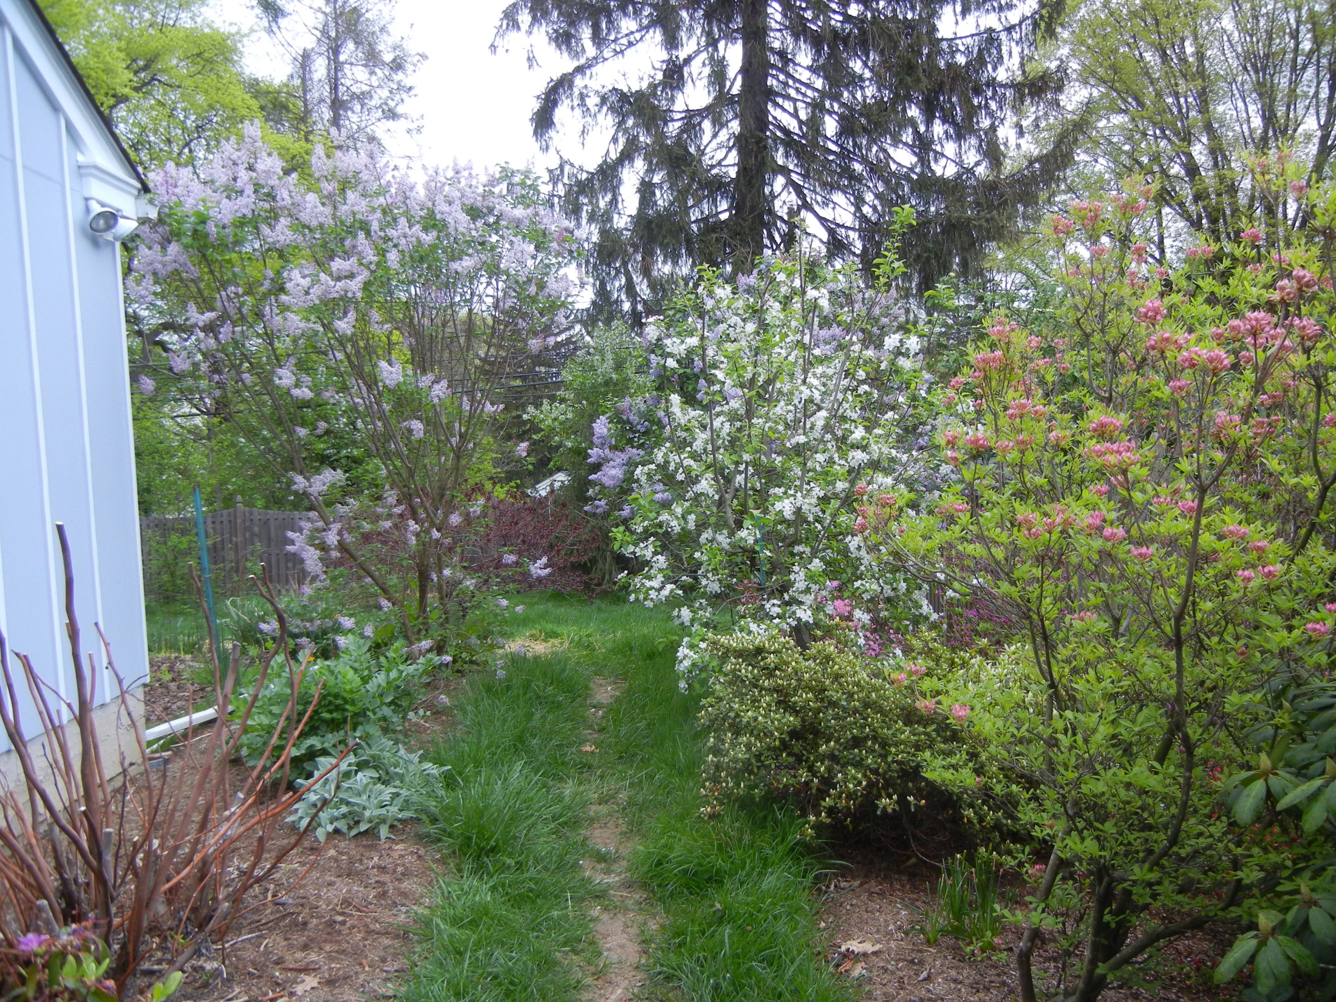
Lilac tree
Jonagold Apple Tree
Native deciduous
azalea
lovage
lambsears
Fig tree
South Side Yard

Slide 22
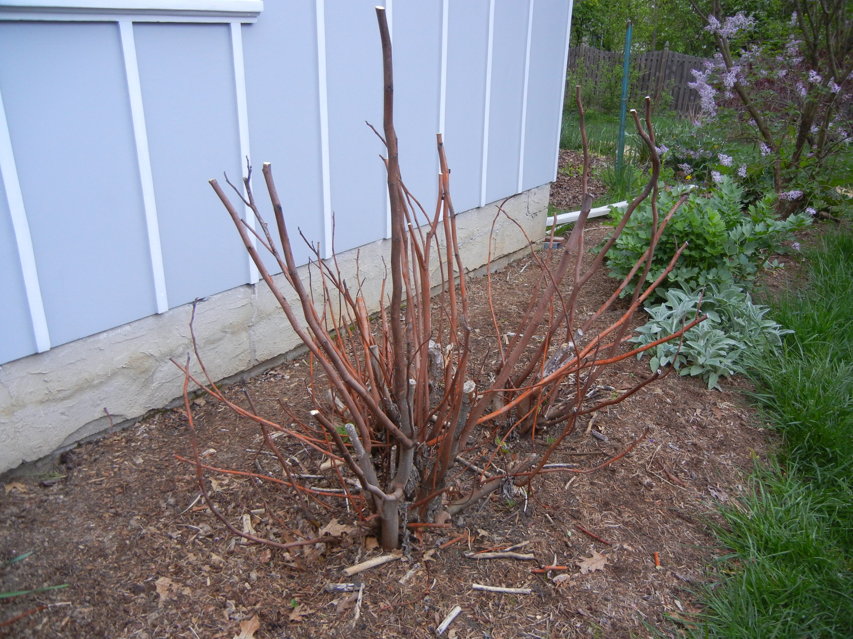
Fig Tree
(It’s still asleep)

Slide 23
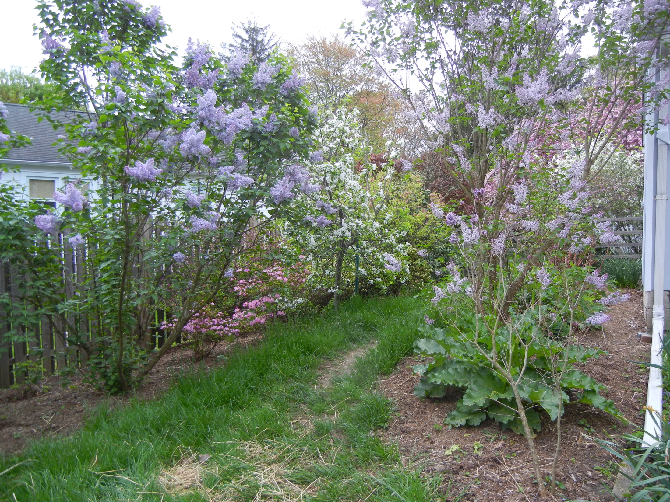
lilac
Jonagold apple tree
lilac
azaleas
South Side yard
rhubarb

Slide 24
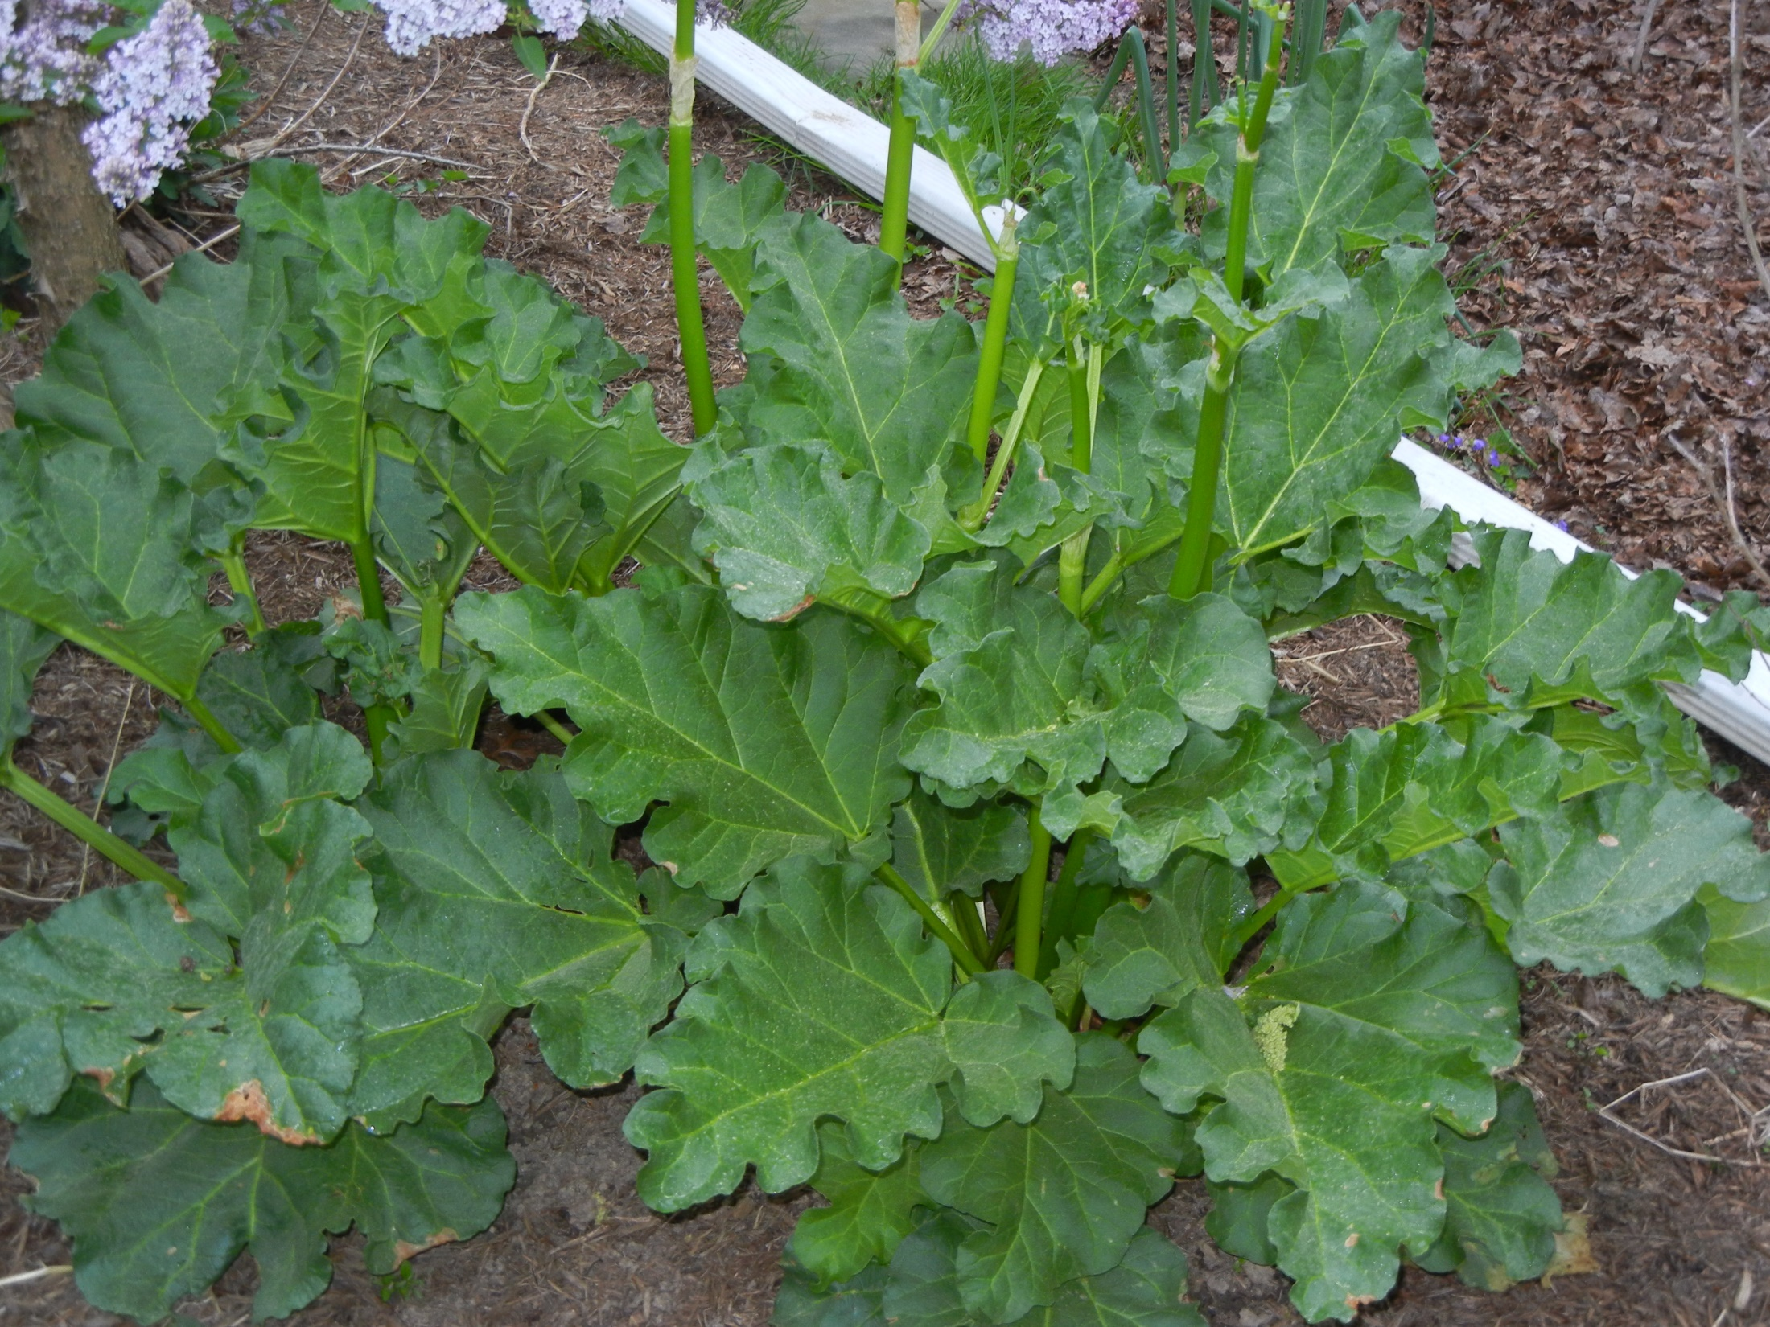
rhubarb

Slide 25
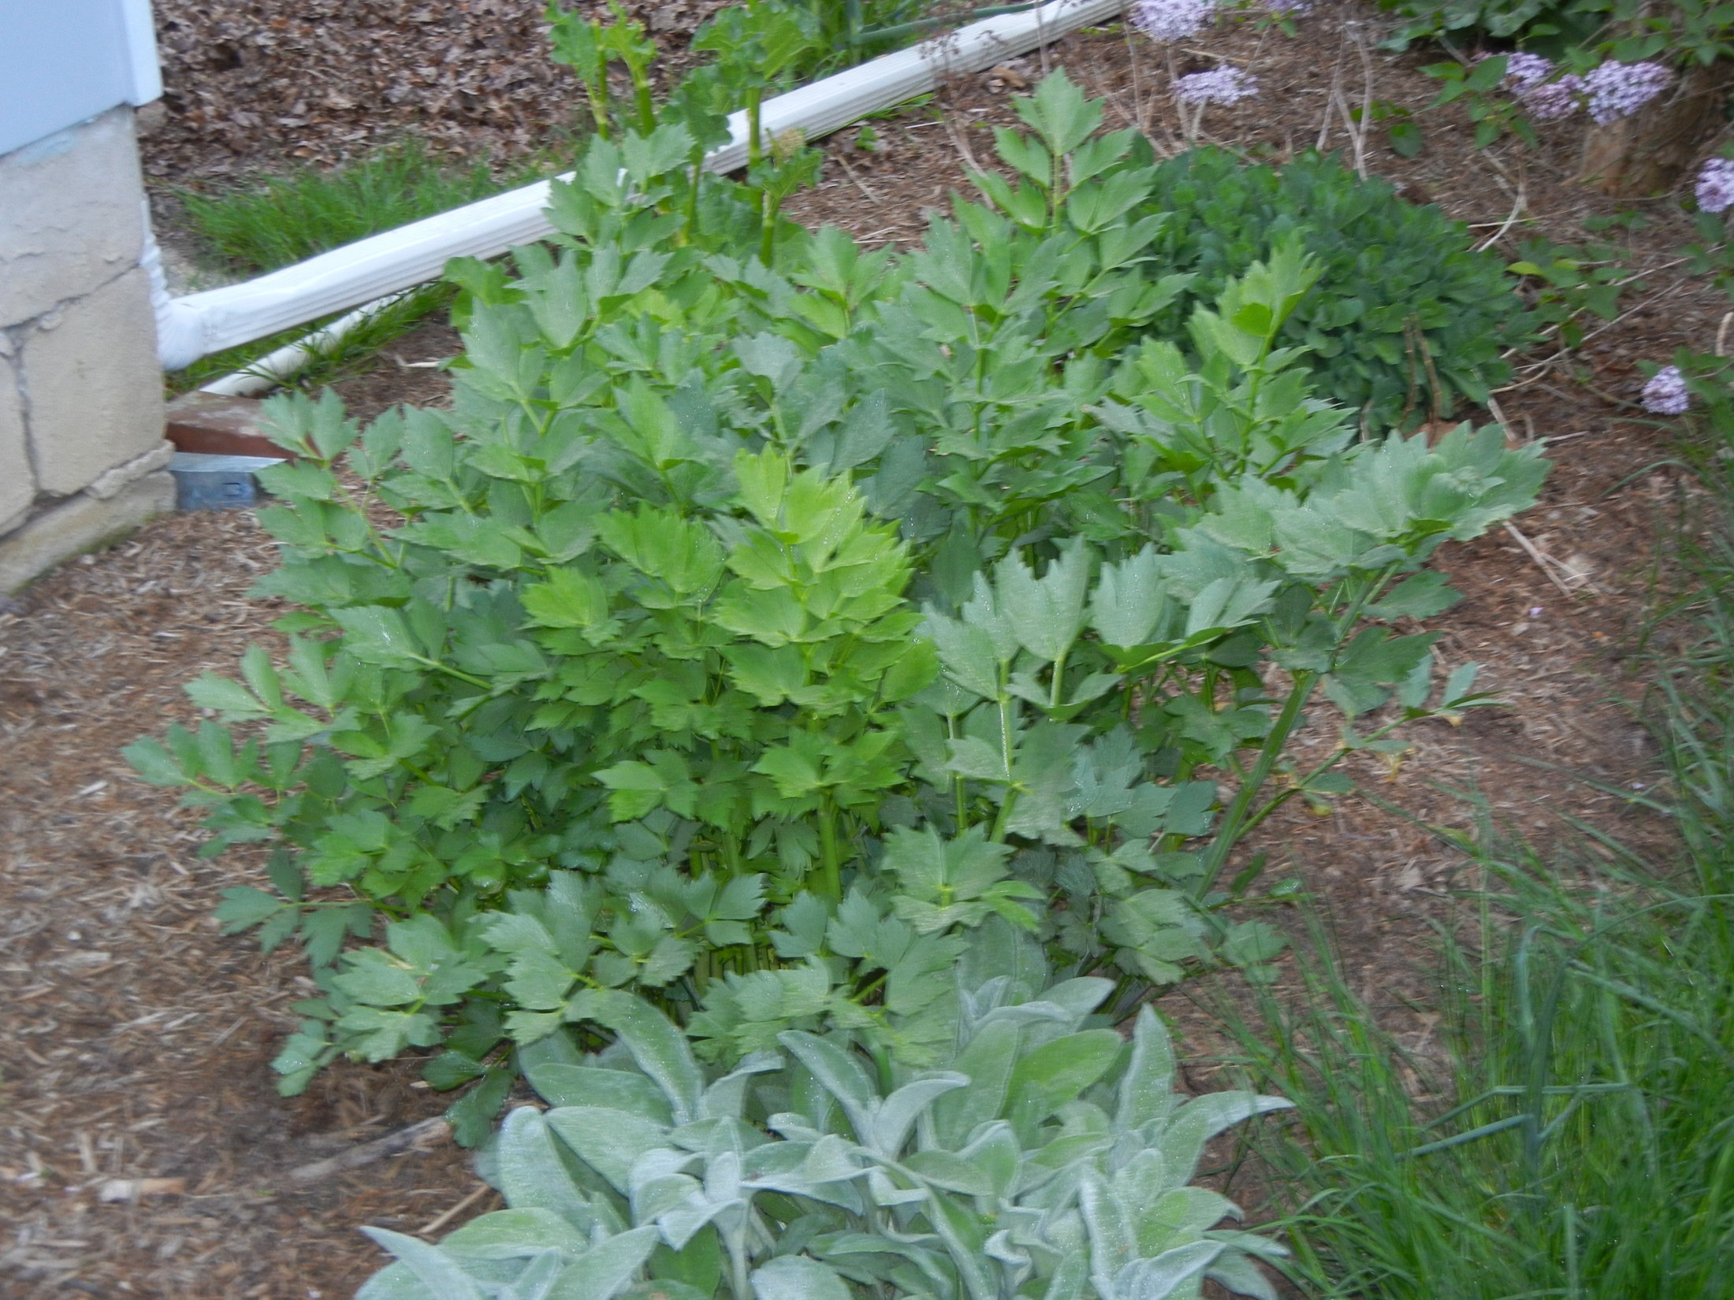
Lovage

Slide 26
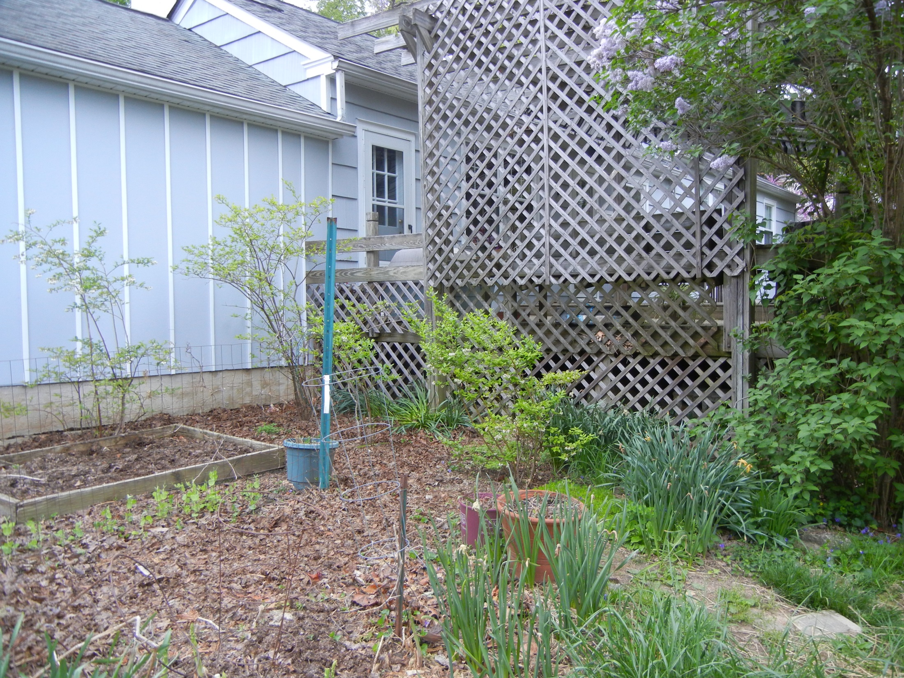
lilac
Blueberry bush
Blueberry bush
Blueberry bush
Aspargus Patch

Slide 27
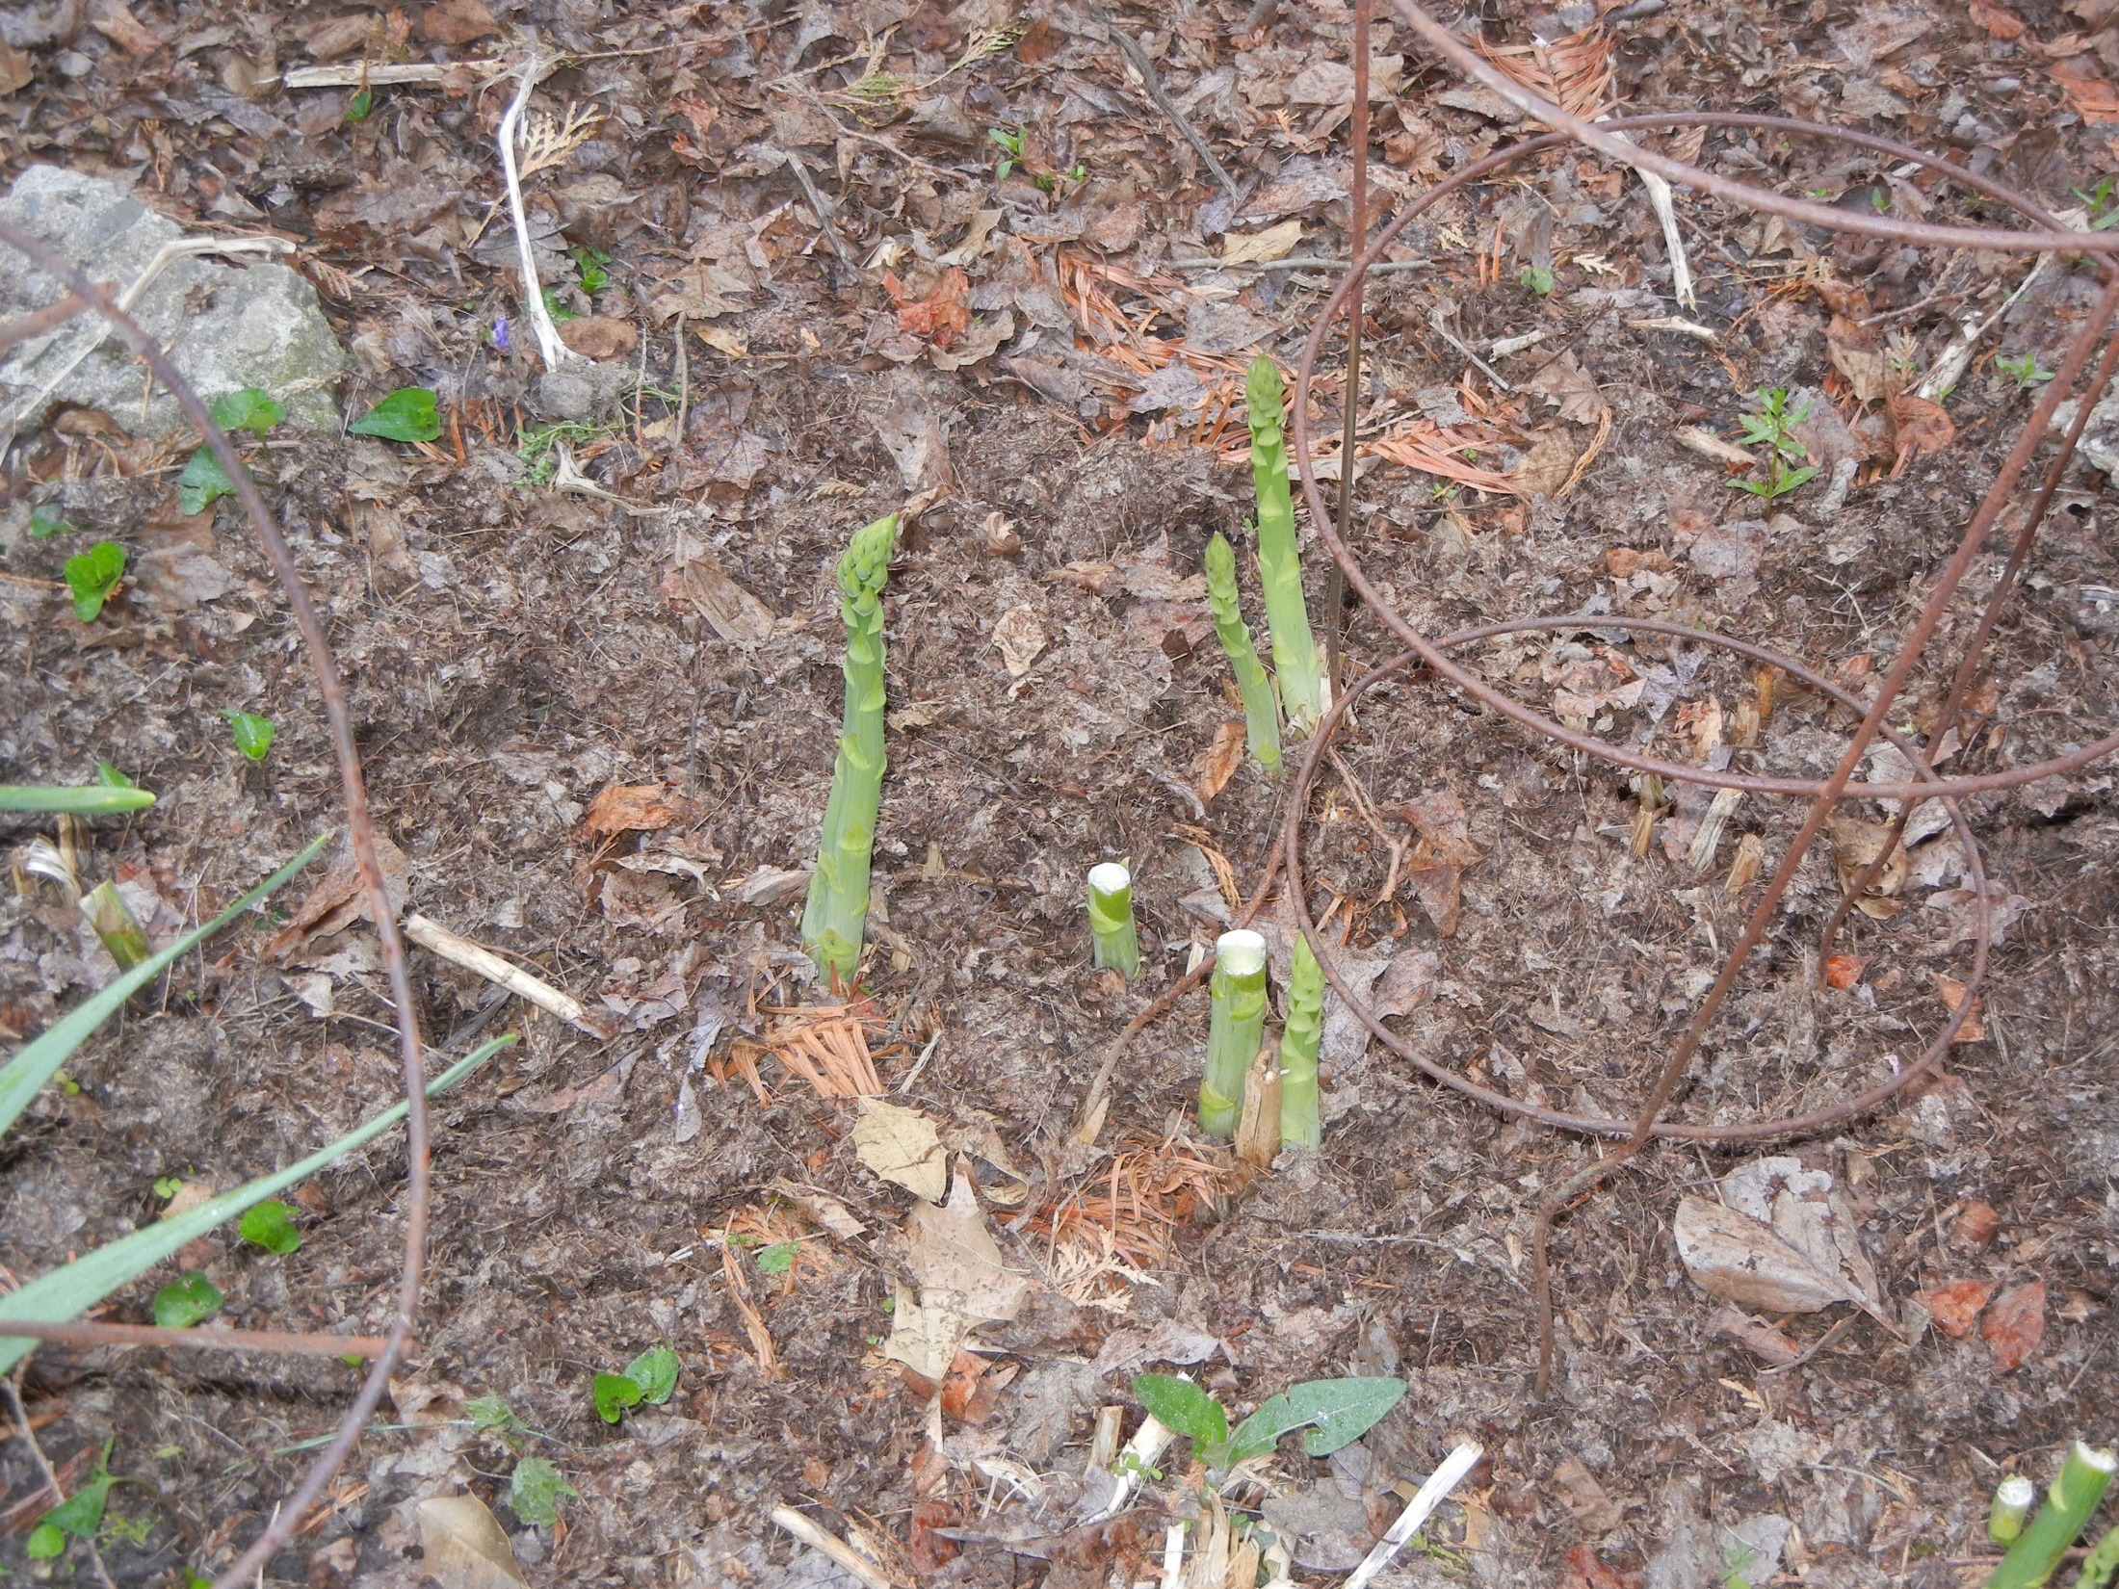
Asparagus patch

Slide 28
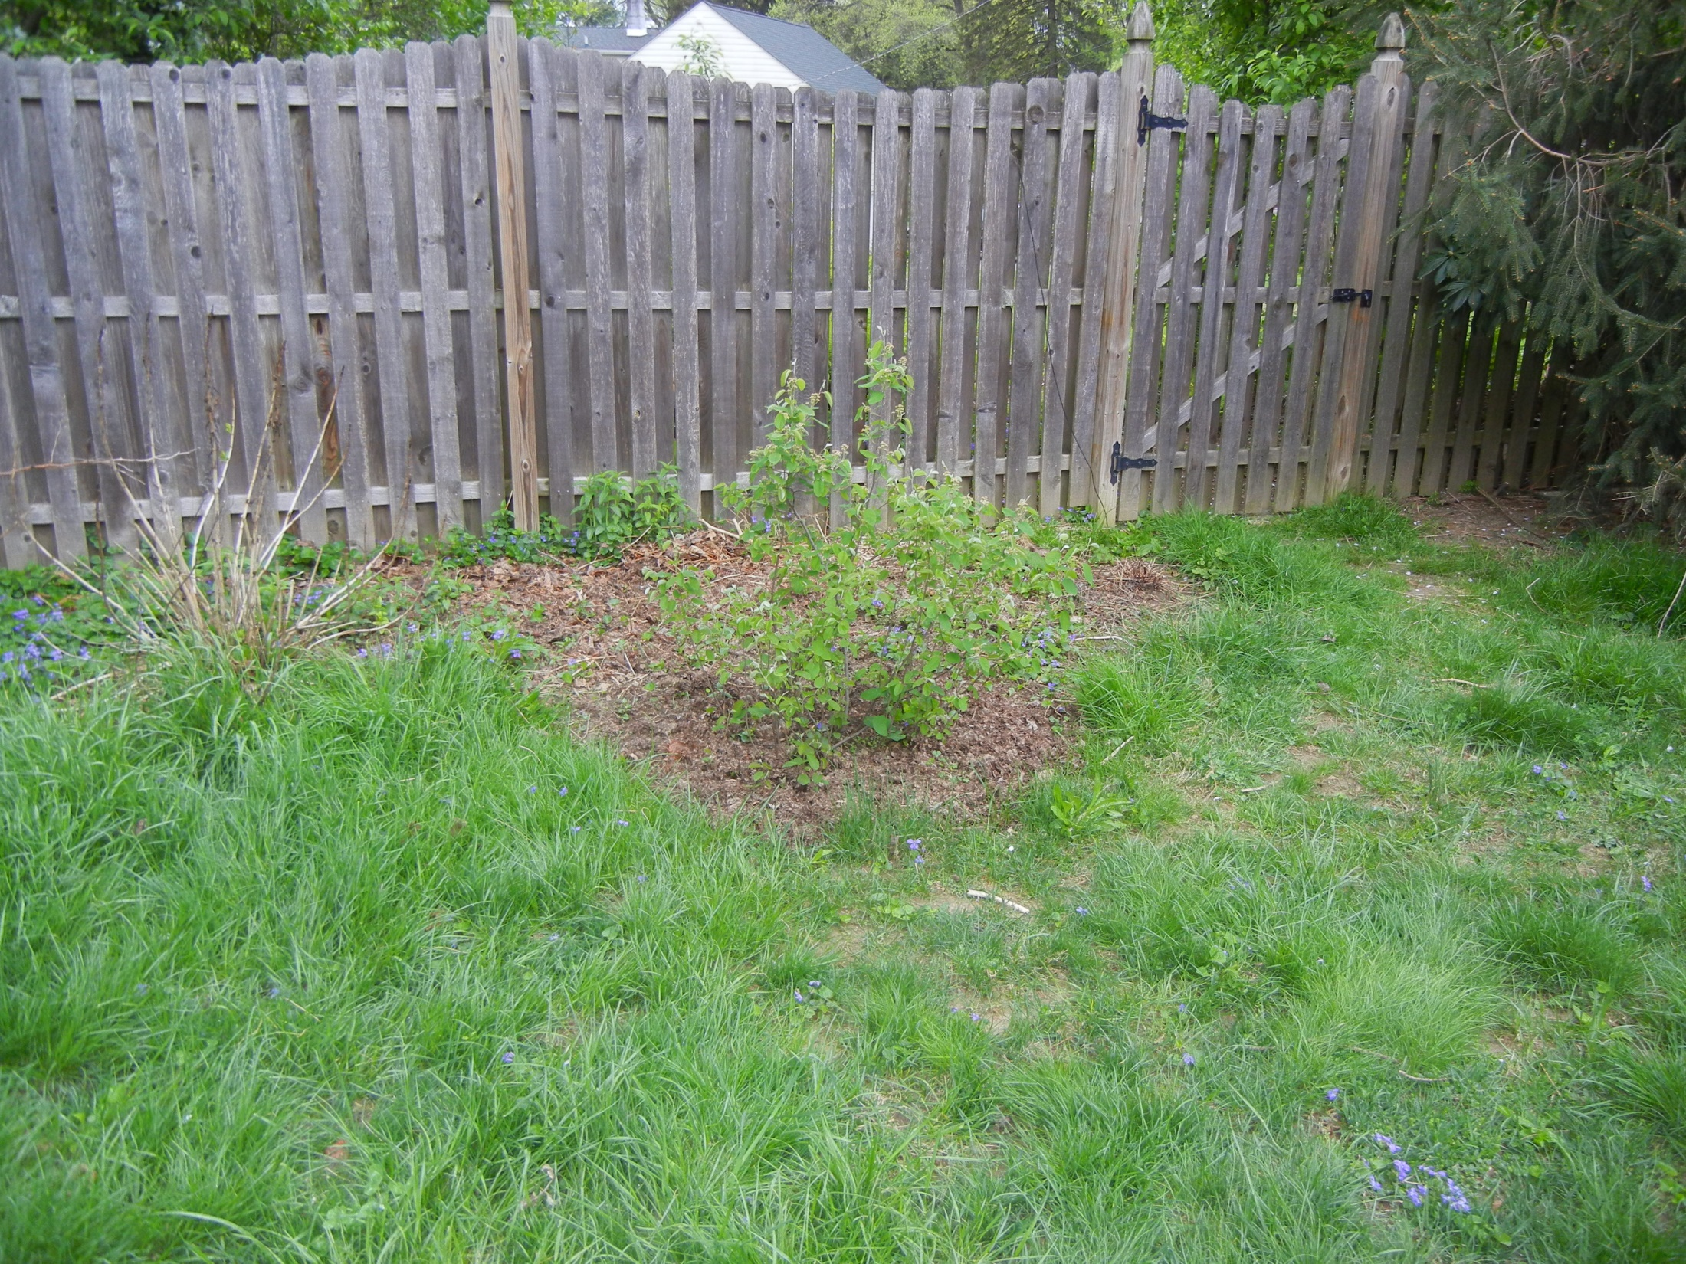
hydrangia
Shadblow Serviceberry
Backyard

Slide 29
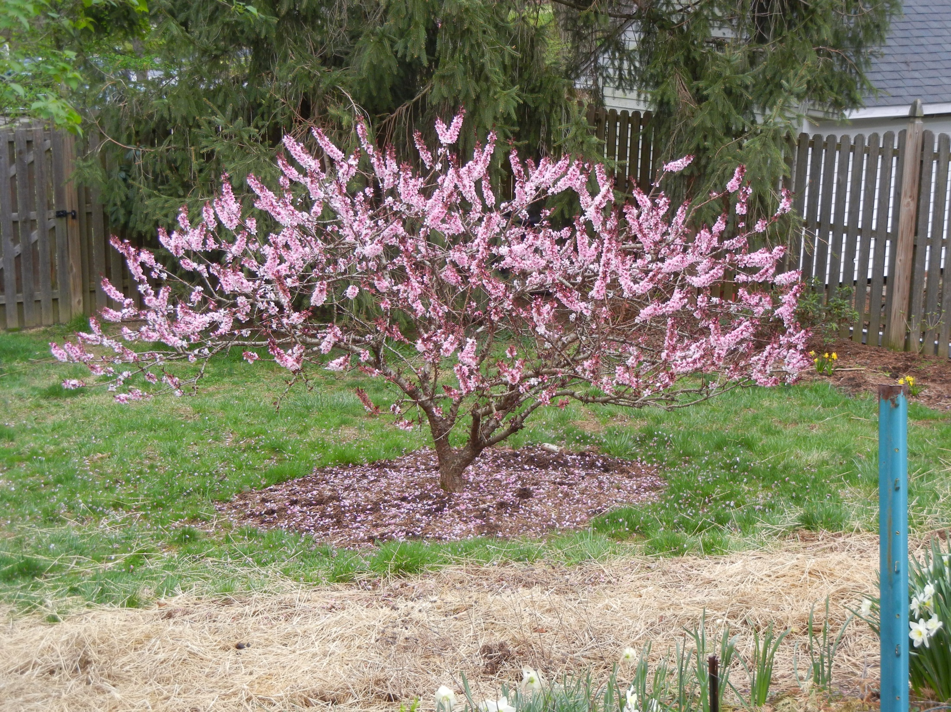
Backyard
Bonfire peach tree

Slide 30
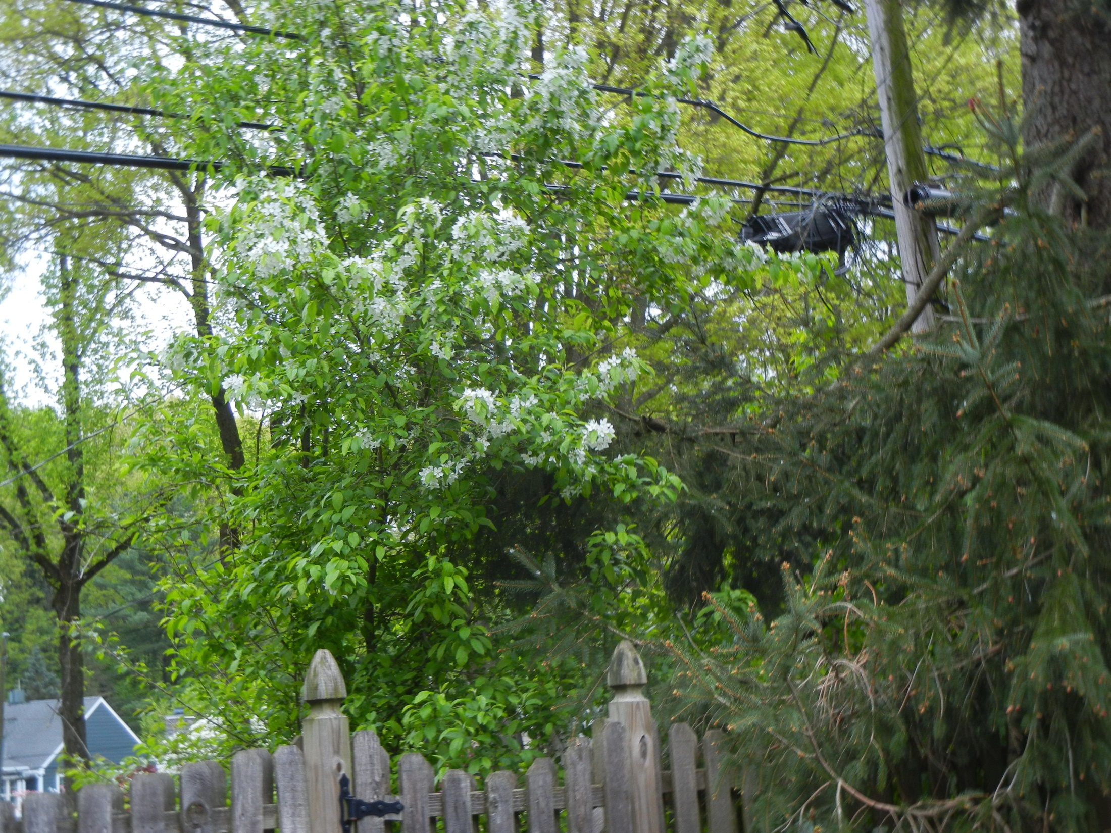
Crabapple
East yard behind fence

Slide 31
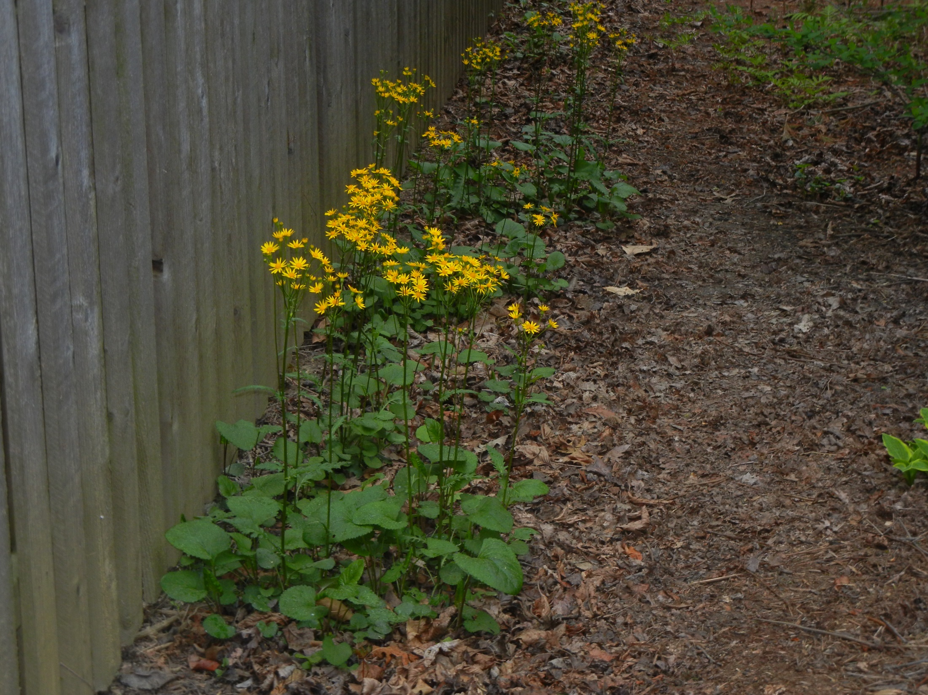
East yard behind fence
Golden ragwort

Slide 32
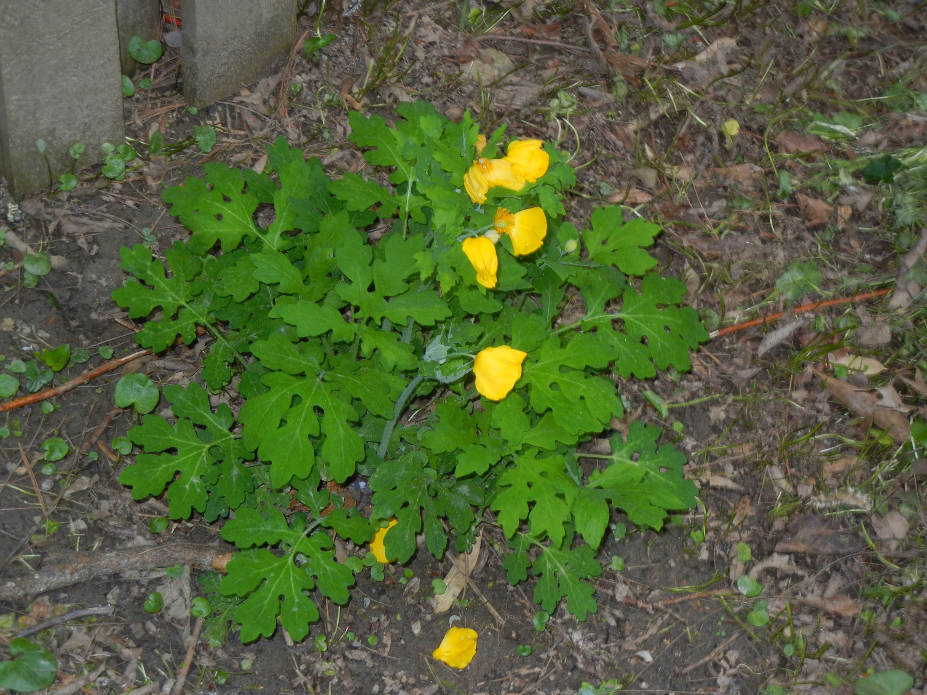
Celandine Poppy
East yard behind fence

Slide 33
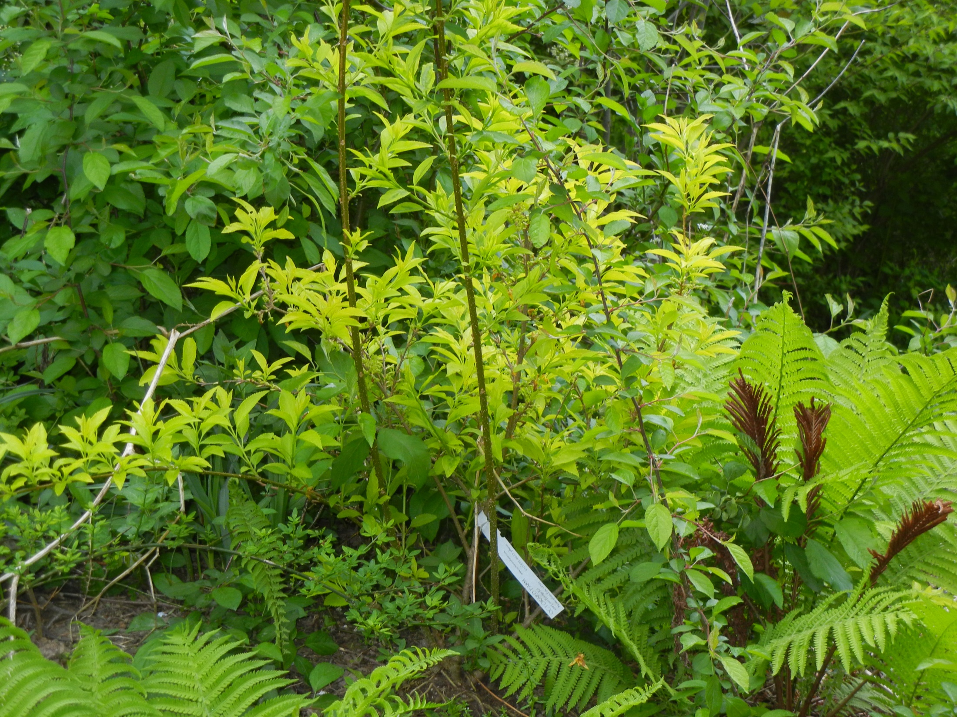
East Yard behind Fence
Forsythia
Note - yellow foliage
Ostrich fern

Slide 34
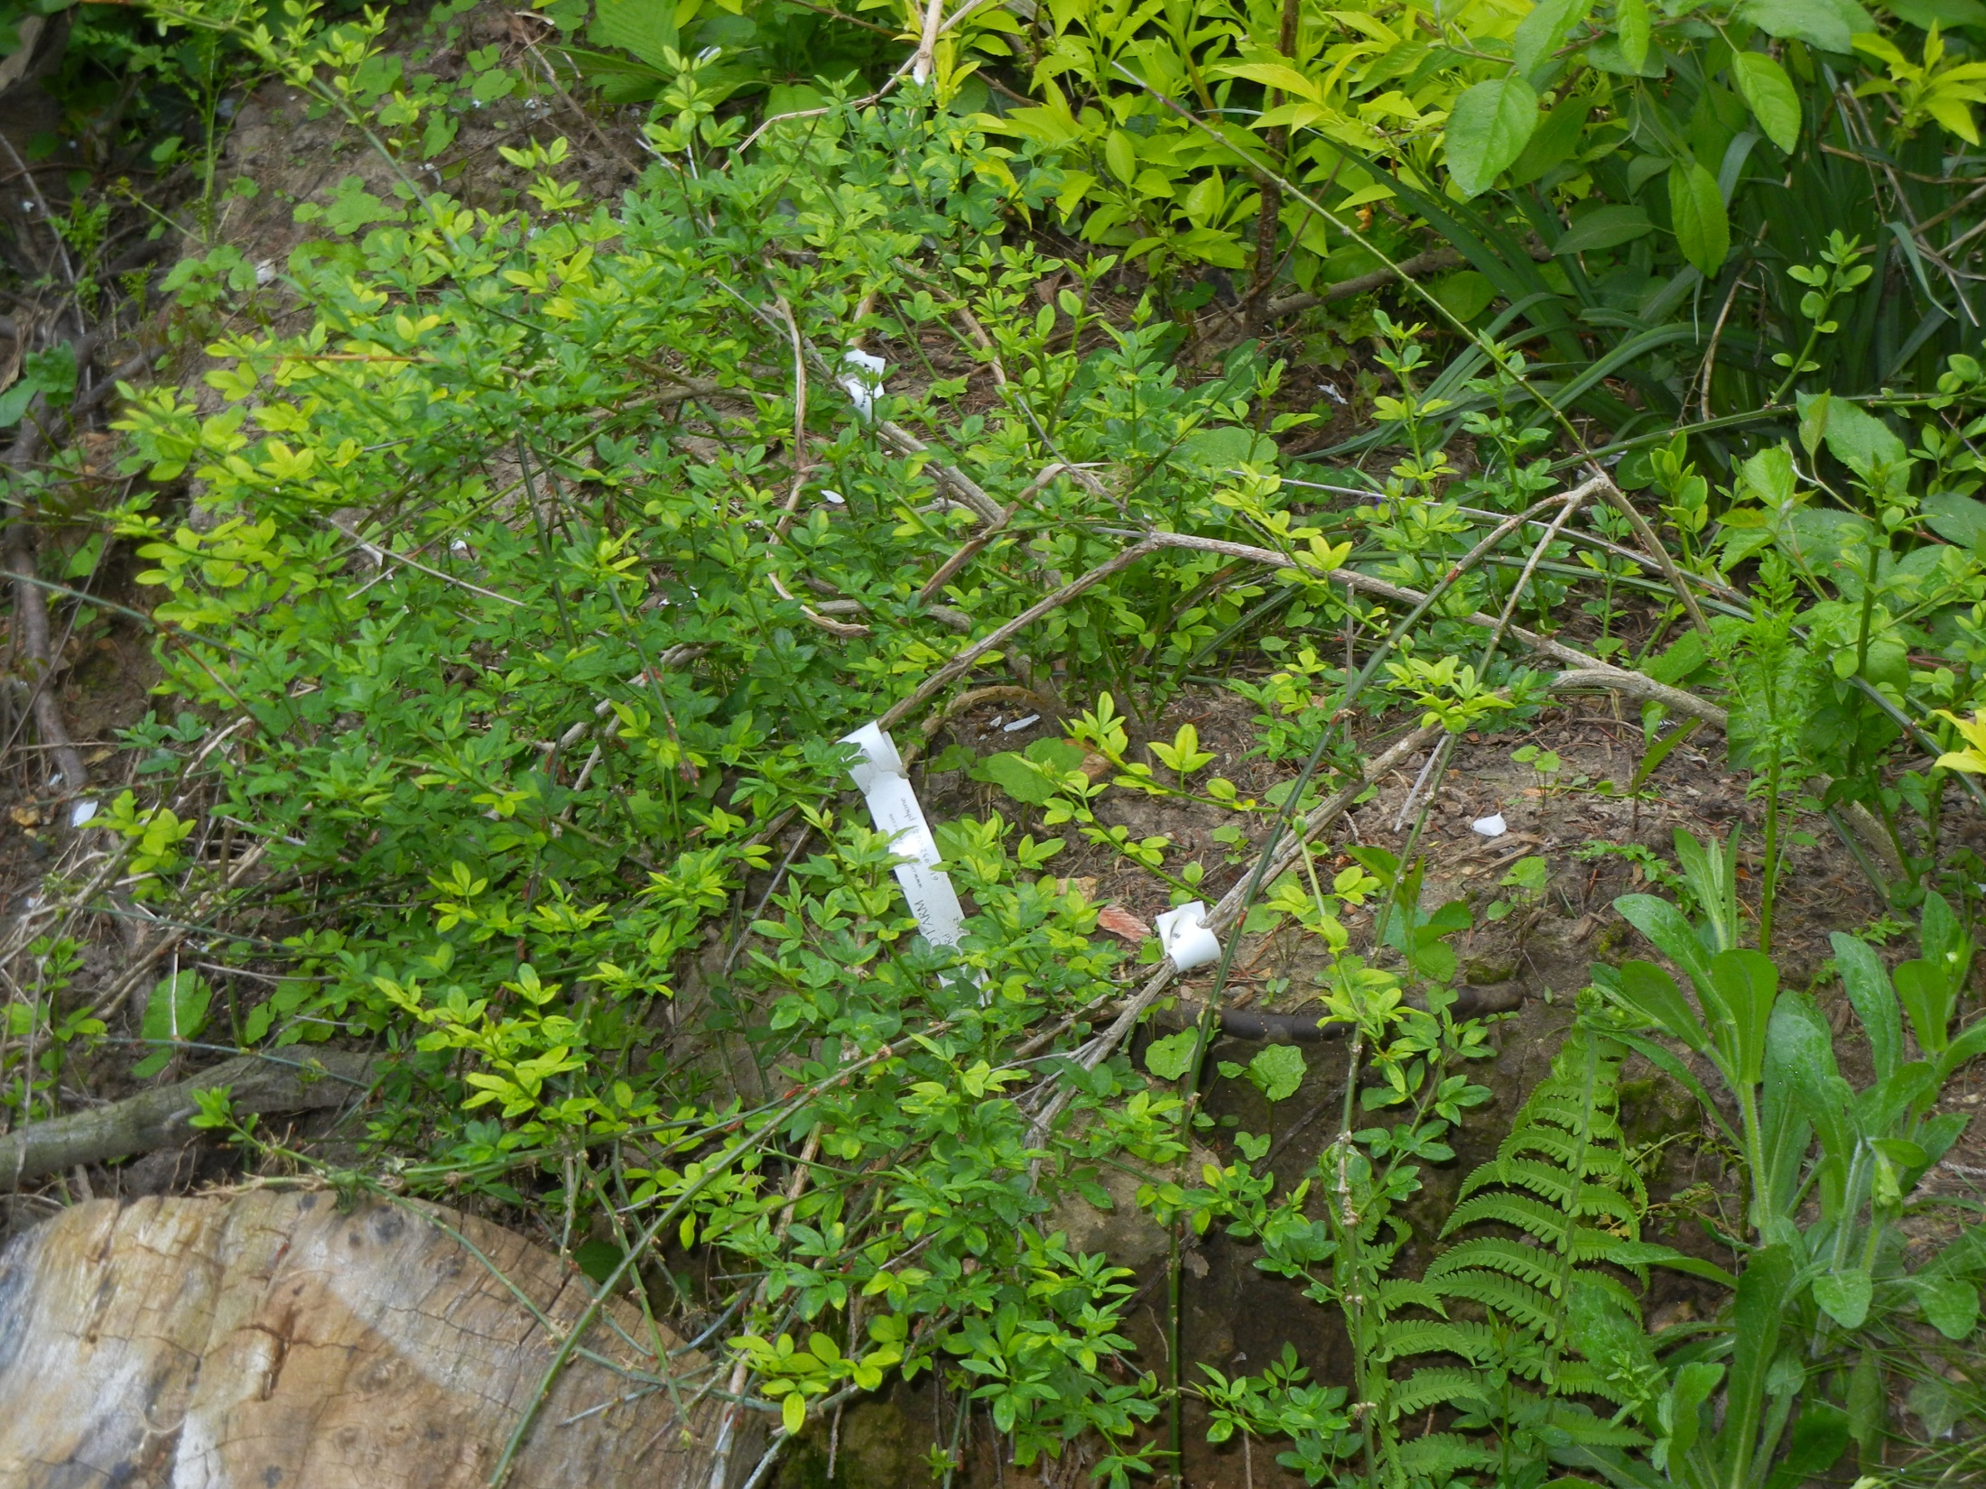
East Yard behind Fence
Winter Jasmine

Slide 35
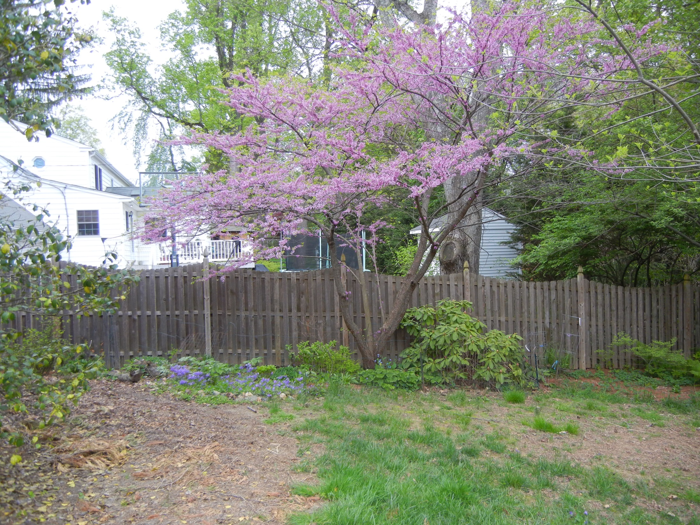
Redbud tree
Rhododendron ‘Tom Everett’
Woodland garden
North Side Yard

Slide 36
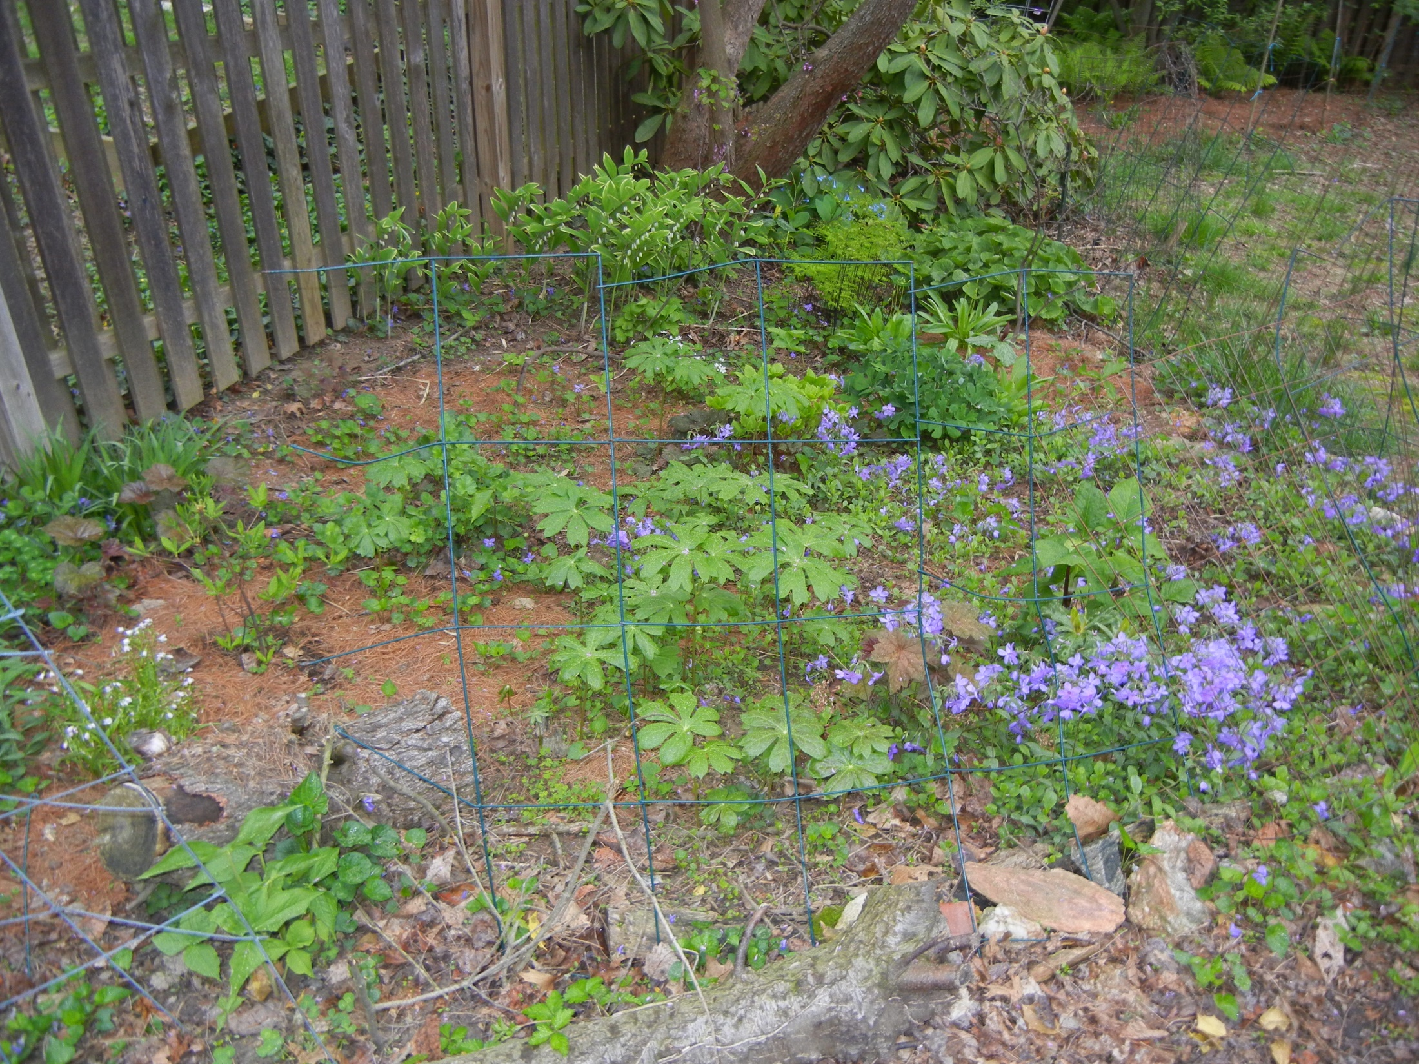
North side yard
Woodland garden
Varigated Solomon's seal
Maidenhair fern
Wild ginger
hepatica
Shooting star
Rue anemone
bloodroot
spiderwort
heuchera
Jack-in-the-pulpit
May apple
Spring beauty
Creeping phlox

Slide 37
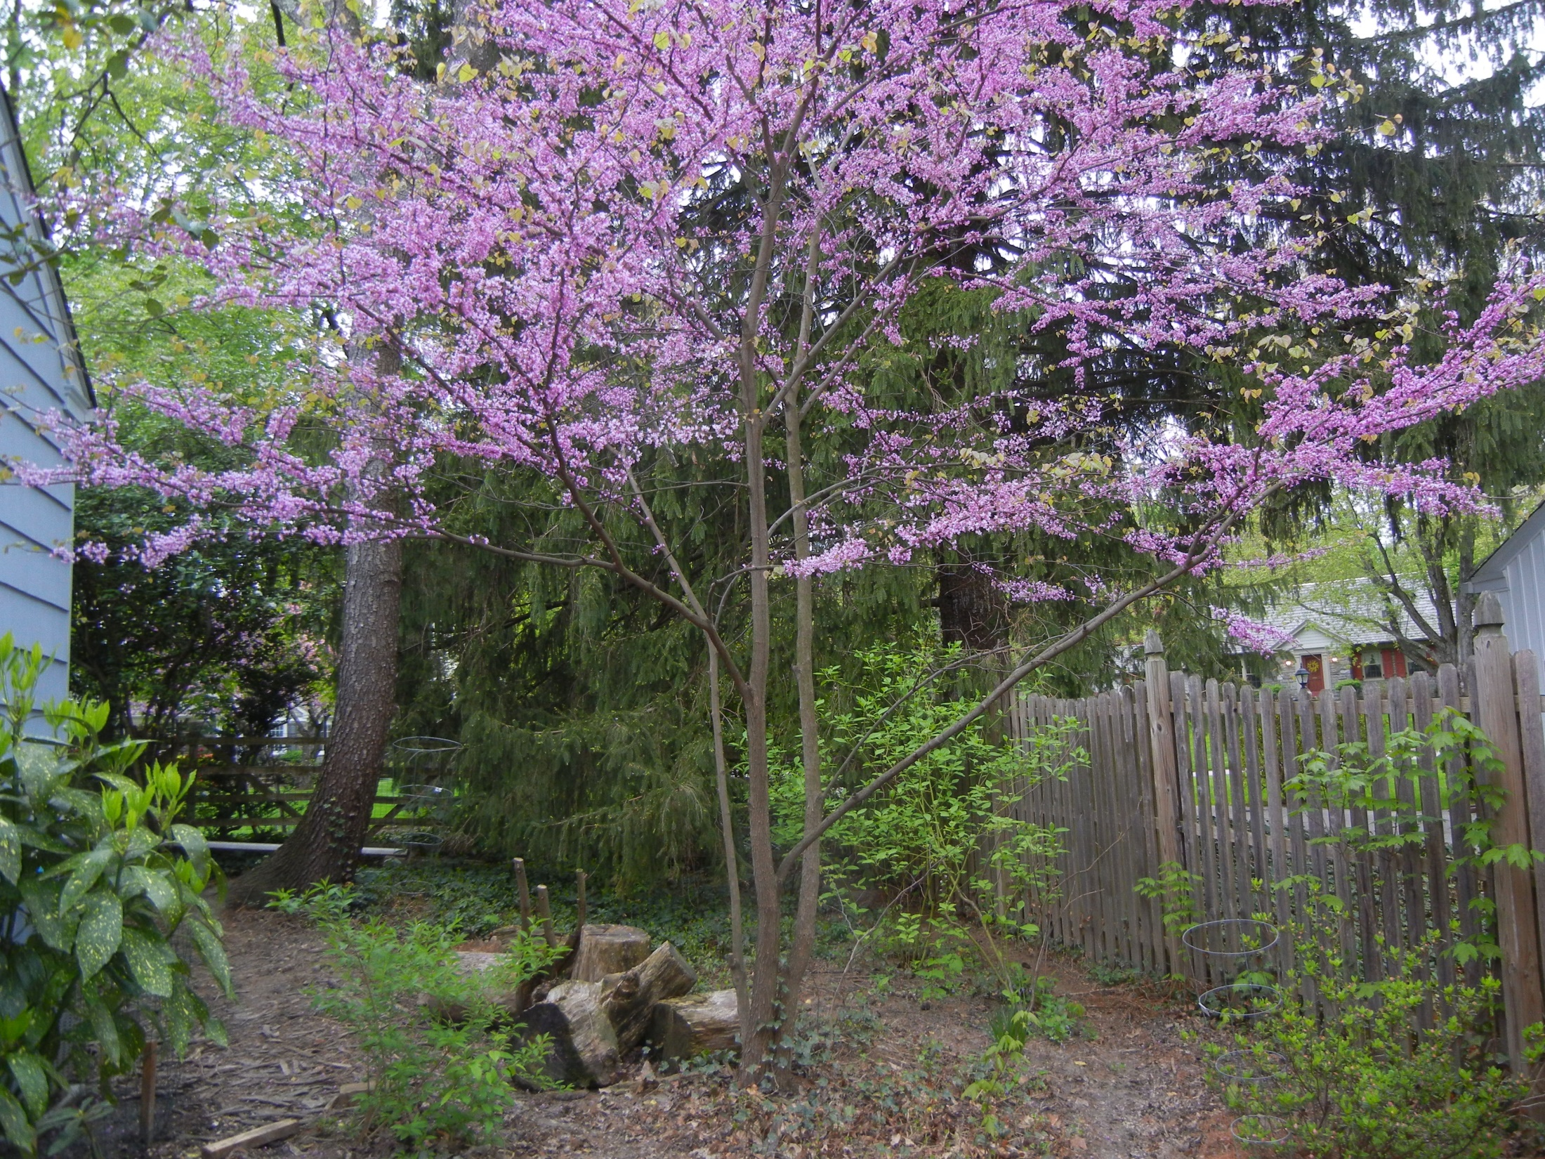
Norway spruce
North Side yard
Redbud Tree
Redtwig dogwoods (3 of them)
Evergreen Azalea ‘Rosebud’

Slide 38
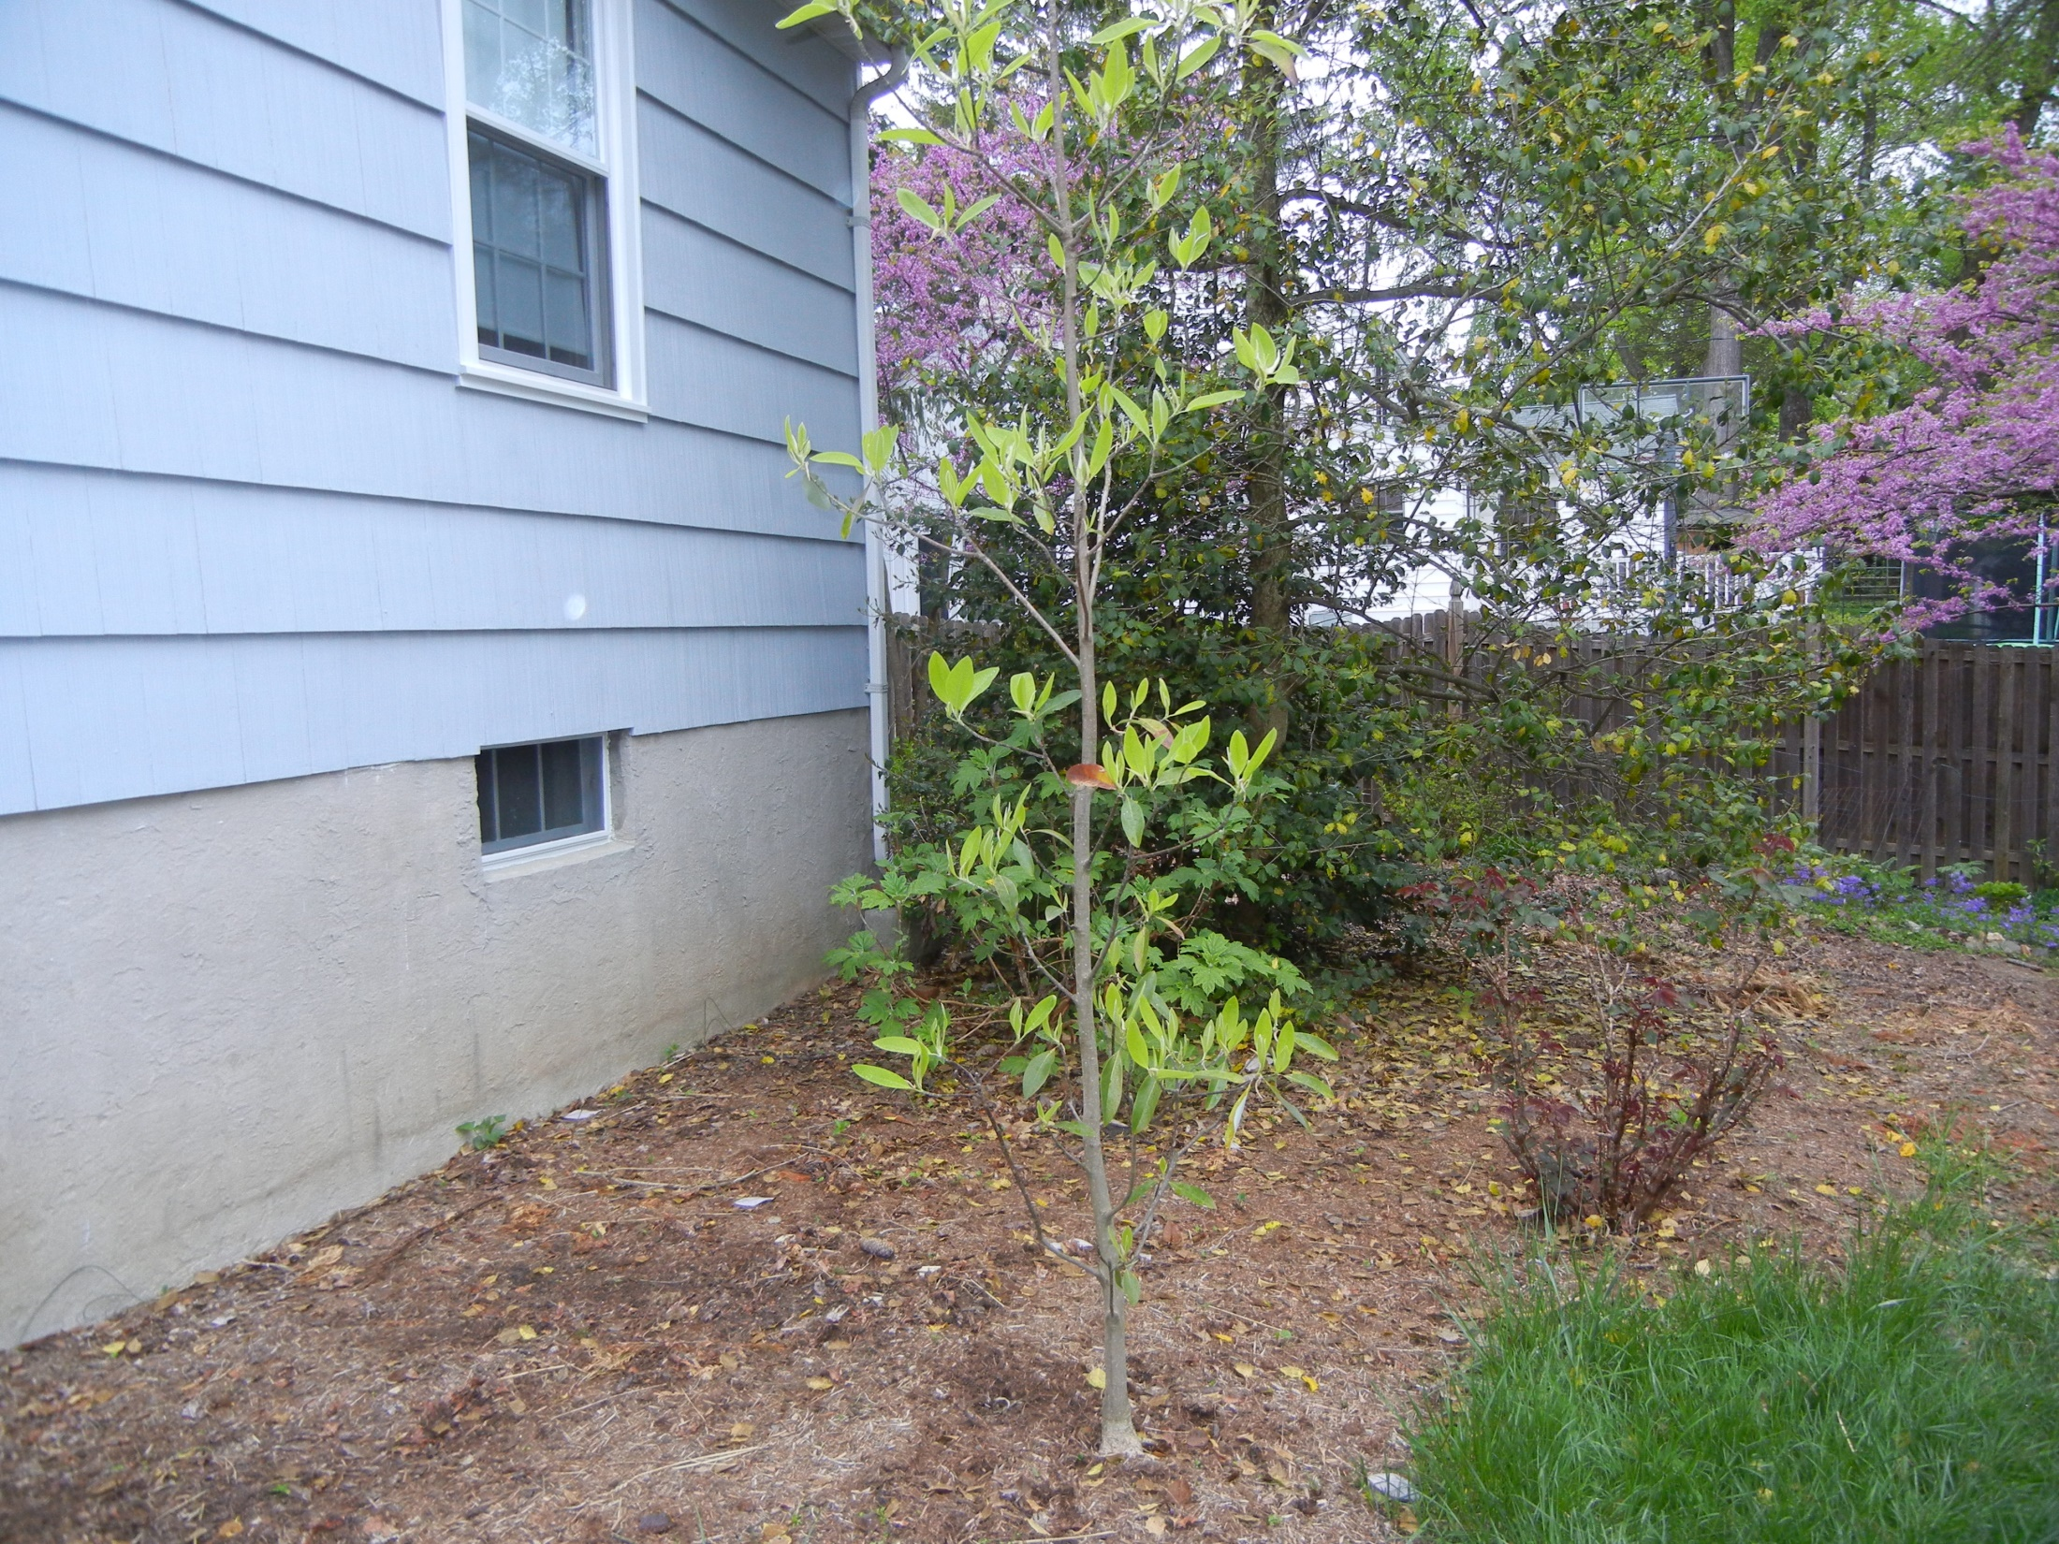
Back of house
Knockout rose
‘Northern belle’ Sweetbay magnolia

Slide 39
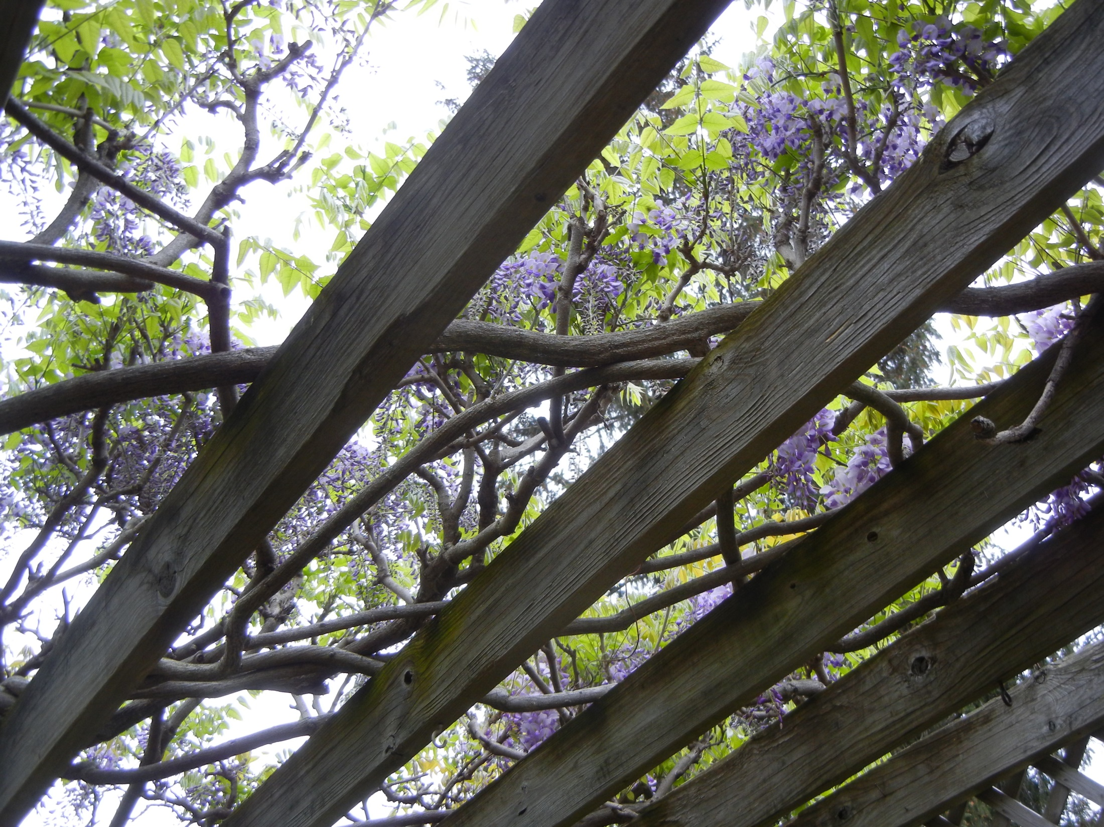
Arbor over deck
Japanese Wisteria

Slide 40
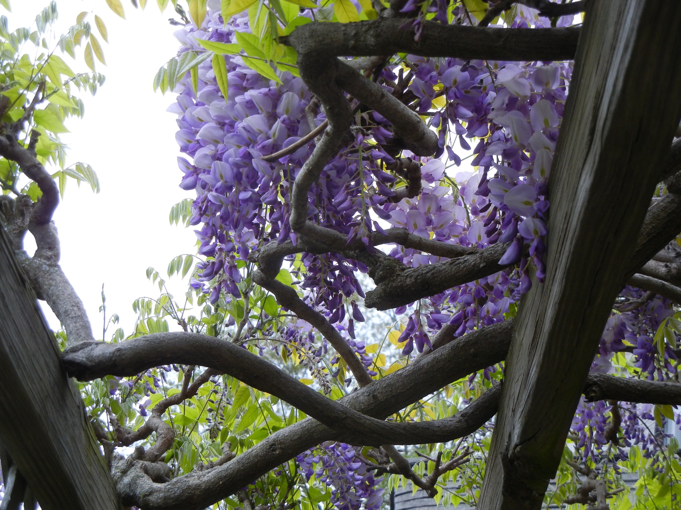
Japanese Wisteria

